Slide 1
Social Security: With You Through Life’s Journey…
Social Security Retirement
October 13, 2021
Produced at U.S. taxpayer expense

Slide 2
Presentation Overview – 2021
Program Introduction
Retirement Benefits
Spouse Benefits
Survivor Benefits
Medicare
Q & A
Information contained in this presentation is subject to changes in legislation, policies, or procedures

Slide 3
Did You Know?
There were over 4.7 million reports of fraud, identity theft and other reports to the Federal Trade Commission in 2020.
1 in 5 people lost money in imposter scams in 2020, totaling $1,190 million.

Slide 4
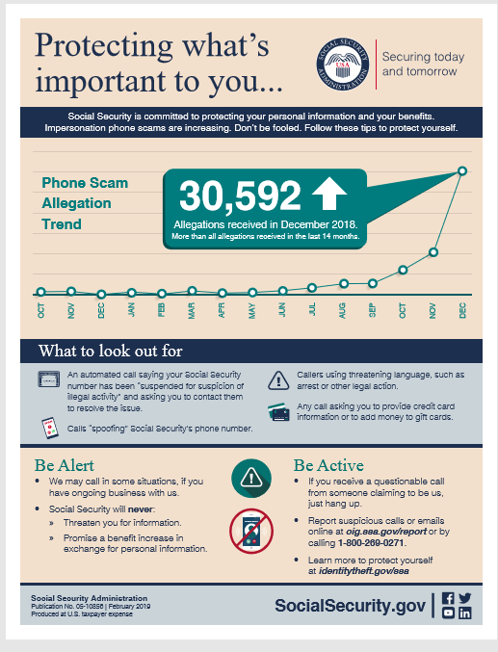
Report scams/fraud:
oig.ssa.gov
Need Help?
IdentityTheft.gov

Slide 5
We Wouldn’t Miss Your Retirement Party
Information contained in this presentation is subject to changes in legislation, policies, or procedures

Slide 6
How Do You Qualify for Retirement Benefits?
By earning “credits” when you work and pay Social Security taxes
You need 40 credits (10 years of work) and you must be 62 or older
Each $1,470 in earnings gives you one credit
You can earn a maximum of 4 credits per year
Note: To earn 4 credits in 2021, you must earn at least $5,880.
ssa.gov/planners/credits.html

Slide 7
How Social Security Determines Your Benefit
Benefits are based on earnings
Step 1 - Your wages are adjusted for changes in wage levels over time
Step 2 - Find the monthly average of your 35 highest earnings years
Step 3 - Result is “average indexed monthly earnings”
ssa.gov/OACT/COLA/Benefits.html

Slide 8
What Is the Best Age to Start Receiving Social Security Retirement Benefits?
Note: This example assumes a benefit of $1,000 at a full retirement age of 66

Slide 9
Benefits Chart by Age
Year of Birth | Full Retirement Age | A $1000 retirement benefit taken at age 62 would be reduced by | A $500 spouse benefit taken at age 62 would be reduced by
1943-1954 | 66 | 25% | 30%
1955 | 66 and 2 months | 25.83% | 30.83%
1956 | 66 and 4 months | 26.67% | 31.67%
1957 | 66 and 6 months | 27.5% | 32.5%
1958 | 66 and 8 months | 28.33% | 33.33%
1959 | 66 and 10 months | 29.17% | 34.17%
1960 + | 67 | 30% | 35%
ssa.gov/oact/quickcalc/earlyretire.html

Slide 10
Retirement Estimator
Gives estimates based on your actual Social Security earnings record
You can use the Retirement Estimator if:
You have enough Social Security credits at this time to qualify for benefits and
You are not:
Currently receiving benefits on your own Social Security record;
Waiting for a decision about your application for benefits or Medicare;
Age 62 or older and receiving benefits on another Social Security record; or
Eligible for a Pension Based on Work Not Covered By Social Security.

Slide 11
Working While Receiving Benefits
If you are | You can make up to | If you earn more, some benefits will be withheld
Under Full Retirement Age | $18,960/yr. | $1 for every $2
The Year Full Retirement Age is Reached | $50,520/yr. before month of full retirement age | $1 for every $3
Month of Full Retirement Age and Above | No Limit | No Limit
Retirement Earnings Test Calculator:
ssa.gov/OACT/COLA/RTeffect.html

Slide 12
Taxation of Social Security Benefits
Your adjusted gross income + Nontaxable interest + ½ of your Social Security benefits = Your “combined income”
Publication 554, Tax Guide for Seniors
Publication 915, Social Security and Equivalent Railroad Retirement Benefits
IRS.gov

Slide 13
Will I pay federal taxes on my benefits?
If you:
file a federal tax return as an "individual" and your combined income* is
between $25,000 and $34,000, you may have to pay income tax on up to 50 percent of your benefits.
more than $34,000, up to 85 percent of your benefits may be taxable.
file a joint return, and you and your spouse have a combined income* that is
between $32,000 and $44,000, you may have to pay income tax on up to 50 percent of your benefits
more than $44,000, up to 85 percent of your benefits may be taxable.
are married and file a separate tax return, you will probably pay taxes on your benefits.

Slide 14
We’re There For Your Wedding

Slide 15
Benefits for a Spouse
Maximum benefit = 50% of worker’s unreduced benefit
Reduction for early retirement
If spouse’s own benefit is less than 50% of the worker’s, they will be combined to equal to 50% of the worker’s
Does not reduce payment to the worker
Benefit is unreduced if spouse is caring for worker’s child younger than age 16 or disabled
Spouse benefits are not payable until worker collects
ssa.gov/planners/retire/yourspouse.html

Slide 16
Benefits for Divorced Spouses
You may receive benefits on your former spouse's record (even if he or she has remarried) if:
Marriage lasted at least 10 years
You are unmarried
You are age 62 or older
Your ex-spouse is at least 62 and eligible for Social Security retirement or disability benefits, even if not collecting
Benefit you would receive based on your own work is less than benefit you would receive based on ex-spouse’s work
ssa.gov/planners/retire/yourdivspouse.html

Slide 17
Auxiliary Benefits for Children
A child must have:
A parent who’s disabled or retired and entitled to Social Security benefits; or
A parent who died after having worked long enough in a job where they paid Social Security taxes.
The child must also be:
Unmarried;
Younger than age 18;
18-19 years old and a full-time student (no higher than grade 12);
18 or older and disabled from a disability that started before age 22.
ssa.gov/planners/retire/applying7.html

Slide 18
We’re There If You Lose A Loved One

Slide 19
Survivor Benefits
Child | May receive benefits if unmarried and younger than age 18 (or younger than 19 if still in high school)
Disabled Child | May receive benefits after age 18 if unmarried (unless married to another beneficiary) and disabled before age 22
Widow/er or Divorced Widow/er (Remarriage after age 60 will not affect benefits) | May receive full benefits at full retirement age or reduced benefits: as early as age 60 as early as 50, if disabled at any age if caring for child younger than 16 or disabled
ssa.gov/planners/survivors/

Slide 20
Survivor Benefits
When you pass away, your surviving spouse may:
At full retirement age, receive 100% of deceased worker's unreduced benefit; or,
At age 60, receive 71.5% of your full benefit and increases each month you wait up to 100% if you start at full retirement age; or
Claim survivor benefits at any age between 60 and full retirement age.

Slide 21
Choosing Between Retirement Benefits and Widow’s Benefits
You can switch to retirement on your own record as early as age 62 if that benefit is higher than your surviving spouse’s benefit.
OR
You can take retirement as early as age 62, then switch to surviving spouse’s at full retirement age if benefit is higher.

Slide 22
Other Survivor Benefits
Lump Sum Death Payment of $255 is a one-time payment to surviving spouse or child(ren) who meet certain requirements
Parents’ Benefits are for a parent age 62 or older who was receiving at least one-half support from deceased son or daughter
ssa.gov/planners/survivors/ifyou.html

Slide 23
Spouse vs. Surviving Spouse Benefits
Spouse (living) | Surviving Spouse (deceased)
May start as early as age 62 | May start as early as age 60 or as early as 50 if disabled
50% if you wait until FRA or later | 71.5% at age 60, increases each month you wait
Less than 50% if you start before FRA (reduction for each month you take benefit early) | 100% if you start at FRA or later
Certain conditions must be met.
ssa.gov/planners/survivors/ifyou.html#h6

Slide 24
How to Apply for Benefits
File online for Retirement, Spouse, Disability, or Medicare Only
If you are disabled, you can file for Retirement and Disability with same application if you are at least 62 but not yet FRA
Survivor* application is not available online
Schedule phone appointment at 1-800-772-1213
Schedule in-office appointment at 1-800-772-1213
*Child and survivor claims can only be done by phone or in office.

Slide 25
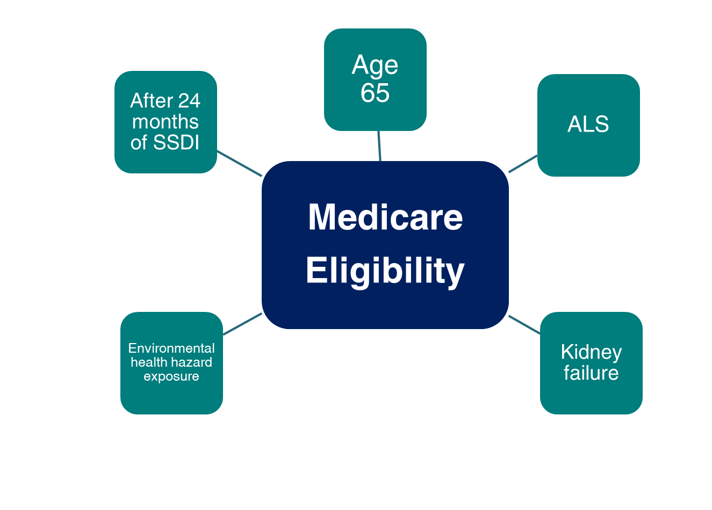
Medicare Eligibility

Slide 26
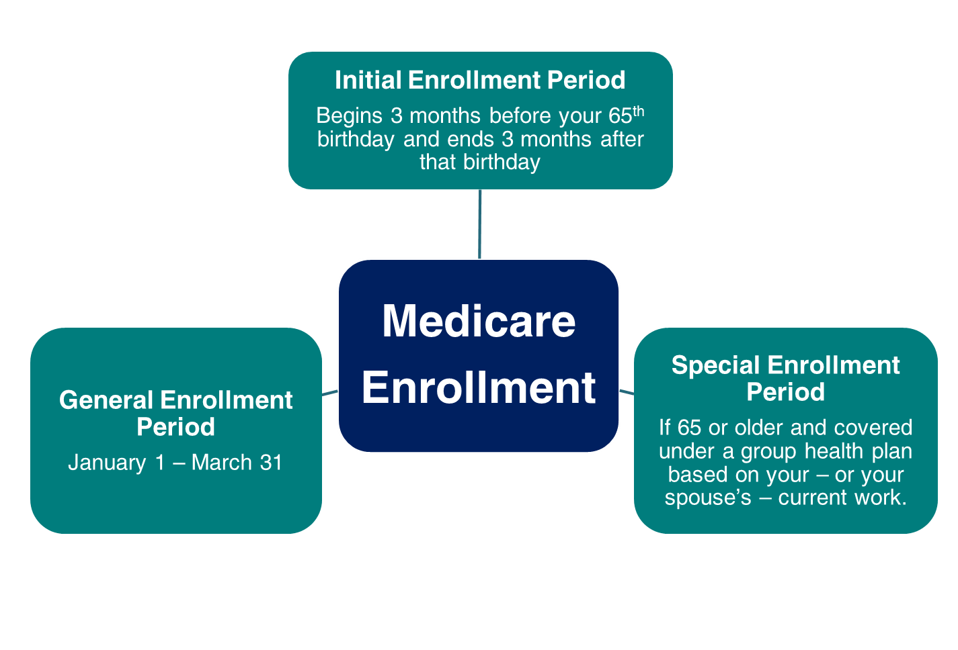
Medicare Enrollment

Slide 27
Medicare Standard Part B Premiums for 2021
If you’re single and file an individual tax return, or married and file a joint tax return:
Modified Adjusted Gross Income (MAGI) | Part B monthly premium amount | Prescription drug plan monthly premium amount
Individuals with a MAGI of $88,000 or less Married couples with a MAGI of $176,000 or less | 2021 standard premium = $148.50 | Your plan premium is $0
Individuals with a MAGI above $88,000 up to $111,000 Married couples with a MAGI above $176,000 up to $222,000 | Standard premium + $59.40 | Your plan premium + $12.30
Individuals with a MAGI above $111,000 up to $138,000 Married couples with a MAGI above $222,000 up to $276,000 | Standard premium + $148.50 | Your plan premium + $31.80
Individuals with a MAGI above $138,000 up to $165,000 Married couples with a MAGI above $276,000 up to $330,000 | Standard premium + $237.60 | Your plan premium + $51.20
Individuals with a MAGI above $165,000 up to $500,000 Married couples with a MAGI above $330,000 up to $750,000 | Standard premium + $326.70 | Your plan premium + $70.70
Individuals with a MAGI equal to or greater than $500,000 Married couples with a MAGI equal to or greater than $750,000 | Standard premium + $356.40 | Your plan premium + $77.10

Slide 28
Social Security Website

Slide 29
my Social Security
ssa.gov/myaccount

Slide 30
How to Open a my Social Security Account
Visit ssa.gov/myaccount
Select: “Sign In or Create an Account”
Provide some personal information to verify your identity (answer “out of wallet” questions)
Choose a username and password
Select how to receive a security code every time you access your account (text or email)

Slide 31
Fact Sheets
Beginning in 2021, we are providing supplemental easy-to-read fact sheets with the Statement to provide information needed to make informed decisions, based on a person’s age and work history.
The fact sheets include:
Four Age-related fact sheets - (Age Groups 18-48, 49-60, 61-69, and 70+)
Four Earnings-related fact sheets for:
Workers with non-covered earnings who may be subject to WEP-GPO,
Workers who are not fully insured,
Workers with an intermittent work history, and
New workers
Medicare fact sheet (ages 62+)
ssa.gov/myaccount/statement.html

Slide 32
Fact Sheet for Workers Ages 49-60

Slide 33
my Social Security Services
If you receive benefits or have Medicare, you can:
Opt out of mailed notices for those available online;
Request a replacement Social Security card if you meet certain requirements;
Report your wages if you work and receive Disability Insurance (SSDI) and/or Supplemental Security Income (SSI) benefits;
Get a benefit verification letter as proof that you are getting benefits;
Check your benefit and payment information and your earnings record;
Change your address and phone number;
Start or change direct deposit of your benefit payment;
Submit your advance designation of representative payee request;
Request a replacement Medicare card; and
Get a replacement SSA-1099 or SSA-1042S for tax season.
ssa.gov/myaccount/what.html

Slide 34
my Social Security Services
If you do not receive benefits, you can:
View retirement benefit estimates at different ages or dates when you want to start receiving benefits;
View possible spouse’s benefits;
Request a replacement Social Security card if you meet certain requirements;
Check the status of your application or appeal;
Get a benefit verification letter as proof that you are not getting benefits;
Get your Social Security Statement to review:
Estimates of your future retirement, disability, and survivor benefits;
Your earnings record, to verify the amounts that we posted are correct; and
The estimated Social Security and Medicare taxes you’ve paid.
ssa.gov/myaccount/what.html

Slide 35
Follow Us on Social Media!
@SocialSecurity

Slide 36
Q&A Session
Participation in this presentation does not constitute an endorsement by the Social Security Administration (SSA) or its employees of the organizations and information and products not provided by SSA.

