Slide 2

Building Effective Assessments

Slide 3
Zoom Whiteboard
What is your biggest concern or frustration with assessment?

Slide 4
Session Objectives
Distinguish between assessment and evaluation
Review types and purposes of assessment
Explain principles of sound assessment
List the categories of assessment
Review examples of learning objective-assessment alignment

Slide 5
Assessment vs. Evaluation
Assessment
  methods used to gather evidence
  evidence of learners’ knowledge and skills
Evaluation
  often involves grading
  formation of a judgment
Notes:
Today, we will focus on assessment

Slide 6
Categories of Assessment
Diagnostic
-Determines what learners know and don’t know
-Supports instructional planning
Formative
-Evaluates the learning process
-Assesses learner’s progress
Summative
-At the end
-Determine learner knowledge & skills related to learning goals
-Formal
Notes:
Establish some basic definitions—likely not new to you, but I want us starting from the same place

Slide 7
Principles of Sound Assessment
Multiple opportunities to probe a mix of skills, knowledge and understanding over time; photo album rather than snap shot
Varied to measure the different levels of learning identified in the learning objectives and provide learners with different opportunities to show what they know and can do
A good fit with the learning objectives

Slide 8
Purposes of Assessment
Recognizing accomplishments
Promote learner growth
Collect information for instructional decisions
Track learner achievement of learning objectives
Notes:
Evaluating Student Achievement
Monitor Student Progress
Evaluate Program
Make Instructional Decisions

Slide 9
7 Forms of Classroom Assessment
Selected Response
Essay/Long Written Responses
Short Written Response/Academic Prompts
Oral Presentation
Instructor Observation
Learner Self-Assessment
Performance Tasks
Notes:
Important to consider the limitations of each. (in class, outside of class, collaboratively, independently, with or without resources)

Slide 10
Zoom Poll
What types of assessment have you used?

Slide 11
Curriculum, Assessment & Instruction
These three aspects of teaching and learning should be intertwined.

Slide 12

Getting Started
Clear Learning Target
Articulated Purpose
Proper Method

Slide 13
Clear Learning Target and Purpose
What is the level and type of learning?
What knowledge and skills are called for?
What evidence will demonstrate learner mastery of the knowledge and skills?
What is reasonable for you and the learners?
Notes:
If written well, the course objectives will guide you in selecting the best way to assess student learning.

Slide 14

An Example
Explain basic reading and writing processes
Analyze the readability of a text
Demonstrate how to use reading comprehension strategies
Oral or written responses
Project-based approach
Recorded or live presentation
Notes:
These are course level objectives, so the assessments are summative in nature.

Slide 15
Zoom Whiteboard
Please share a learning objective and way you have assessed it (or could assess it).

Slide 16
Assessment Blueprints
Identifies alignment with learning goals.
Supports content validity
Increases instructor awareness of learning goals
Promotes quality assessment
Increases learner awareness of learning goals

Slide 17
An Example: Assessment Blueprint
Learners will:
1. explain basic reading and writing processes as they relate to content literacy and research-based practices. (InTASC 1; lesson plan rationale)
2. select writing techniques can be used to promote and assess content learning. (InTASC 4; comprehension strategy mini-lesson; lesson plan)
3. identify various assessment techniques to support selection of the best methods for teaching content materials that meet the needs and interests of diverse students. (InTASC 6; lesson plan)
Notes:
This is an example of the course learning objectives aligned with the assessments and program objectives.

Slide 18
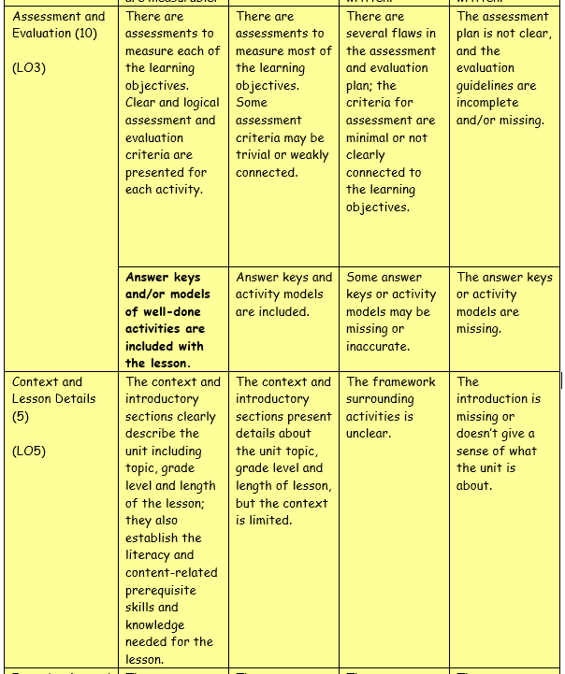
An Example: Assessment Blueprint
Notes:
This is an example of the rubric used for an assessment aligned with the learning objectives.

Slide 19
Learning Objectives:
From Course to Session
Analyze the readability of a text
  Define readability
  Know elements of readability
  Locate reliable readability calculators
  Compare and contrast readability and reader ability
  Identify text features that affect readability
  Determine appropriate grade level for text
Formative Assessments
Quizzes
Exit Slips
In-class activities like a Venn Diagram
Application exercises
Notes:
These are just a few examples, and these objectives can and should be formatively assessed in multiple ways.

Slide 20
Zoom Whiteboard
What would you like to do better or know more about regarding assessment?

Slide 21

Writing Good Test Items

Slide 22
Begin with the Learning Goals
Generally…
Selected response items (matching, T/F, multiple choice, fill-in-the-blank) align with knowledge goals.
Open response items can align with knowledge and understandings.
Notes:
Can skills be measured through a traditional test?
The packet “Assessing Student Learning” provides great tips on writing good test items.

Slide 23
Let’s look at some test items
Identify what is structurally wrong with the items.

Slide 24
True or False Format
George Washington was the nation’s greatest president.
Bo is the name of the president’s dog, and Ashley and Leah are his daughters.

Slide 25
Tips: True or False Format
Remove ambiguity. Your false item is not worth using if you can only write a true version of it by adding the word not.
If your statement asks students to make evaluative judgments, make it into a comparative statement.
  T F Compared to strictly phonics-based approach to reading remediation, a holistic approach has been found to be more successful with most students.
Write false statements that reflect the misconceptions held by students who have not achieved the learning targets.
  T F Not correcting a child who has miscued is detrimental to their continuing development as a reader.
4. Multiple choice items may be rewritten into true-false items using the foils from the multiple choice options.

Slide 26
True or False Item Types
1. True-False
T F The sum of all the angles in any four-sided closed figure equals 360 degrees.
2. Yes-No
Y N Is it possible for a presidential candidate to become President of the United States without obtaining a majority of votes cast on Election Day?
3. Right-Wrong
R W 5 + 3 X 2 = 16
4. Correction
Read each statement below and determine if it is correct or incorrect. If it is incorrect, change the underlined word or phrase to make the statement correct. C I The new student, who we met today, came from Greece.
5. Multiple True-False
Under the Bill of Rights, freedom of the press means that newspapers
have the right to print anything they wish without restrictions.
can be stopped from printing criticisms of the government.
have the right to attend any meeting of the executive branch of the federal government.
6. Yes-No with Explanation
Guided reading is an effective approach to early reading instruction. Yes or No
Explanation:

Slide 27
Multiple Choice
Singer
a. invented the sewing machine
b. won American Idol last season
c. carried the first Olympic torch through the streets of Berlin amidst civil unrest in Russia.
2. Which of the following is best definition of formative assessment?
a. a type of assessment used for grading.
b. a type of assessment used for providing feedback.
c. a type of assessment used for planning instruction.

Slide 28
Matching
Match the items that fit best together.
_____1. Meadow Lark a. Bird
_____2. Bismarck b. Flower
_____3. Prairie Rose c. City

Slide 29
Short Answer
__________ is the capital city of North Dakota.
2. Eli Whitney ________________.
3. A frog is an _______________________.

Slide 30
Essay
List the types of rocks and characteristics of each.

Slide 31
Increasing Likelihood of Validity & Reliability
Align items with learning goals.
Pay attention to overall readability of test.
Provide clear scoring guide for essay items.
Clear, concise instructions.
Conduct item analysis with results.
Have a colleague look over the test.
Have multiple items to test each construct.

Slide 32

Performance Assessments

Slide 33
When is performance assessment appropriate?
When all learners have access to resources needed for success.
When there is adequate time.
When an active, hands-on assessment is the best way to assess a learning goal.

Slide 34
Performance-Based Assessments Categories
Problem-Based | Project-Based | Challenge-Based
Often interdisciplinary |  | Often interdisciplinary
Begins with an ill-defined problem | Begins with an engaging question | Begins with Big Idea
Learners define what they need to learn | Learners produce a product to answer question | Create essential and guiding questions
Real-world context |  | Real-world issue

Slide 35
Start with learning objectives
What do you need to measure?
What is the most authentic and appropriate way to measure it?
Are you measuring the skill and not the task?
Notes:
Consider time constraints, resources, student needs
Performance assessments usually measure several learning goals at once

Slide 36
GRASPS Model
The GRASPS model guides you through determining the essential components of a performance assessment.
Goal
Role
Audience
Situation
Performance
Standards

Slide 37
GRASPS: Goal
Find a way to make water safe and accessible to a remote village in Africa.

Slide 38
GRASPS: Role
Your team includes engineers and scientists working collaboratively to achieve the goal.

Slide 39
GRASPS: Audience
Engineers and scientists from NDSU who will evaluate your work.

Slide 40
GRASPS: Situation
The residents of the African village currently have to walk a mile to the nearest water source and carry it back to their homes. The river water is full of dangerous bacteria that has sickened and even killed several members of the community.
Notes:
This is where you set up the problem, project or challenge.
What type of approach is this?

Slide 41
GRASPS: Product
You will develop a solution for both accessibility and safety of the water. You will provide a written plan with sketches. Additionally, you will build a working scale model of your solution that will be presented to NDSU scientists and engineers.

Slide 42
GRASPS: Standards
An analytic rubric with criteria that aligned to the learning goals.

Slide 43
Developing an Analytic Rubric

Slide 44
Begin by considering…
What important criteria and learning targets need to be measured?
(Understandings, knowledge and skills)
Notes:
After you decide what assessment activity the students will do, you need to decide how you will measure their learning.

Slide 45
Levels of Development
What levels of development should be used to describe the learners achievement of the learning goals? (eg. Developing, Proficient, Advanced Proficient, Unsatisfactory, Satisfactory, Exemplary)
Notes:
You can also use numbers/scores for the levels in place of descriptors or alongside.

Slide 46
The Top-Down Approach to Crafting an Analytic Rubric
Describe the content and performance you want to assess.
Use the learning goals and descriptions from Step 1 to identify the content and/or performance categories for the rubric.
Define the levels of development for each rubric area.
Craft the scoring rubric and review for alignment.
Use the scoring rubric to assess a sample of student work, and revise as necessary.

Slide 47
Analytic Rubric Example
Notes:
Use the unit goals to create the rubric. Consider which goals are being measured by the project and use them as rubric categories. Pay attention to the verbs.

Slide 48
Questions or Comments?
Stacy Duffield
Stacy.Duffield@ndsu.edu

