Slide 1
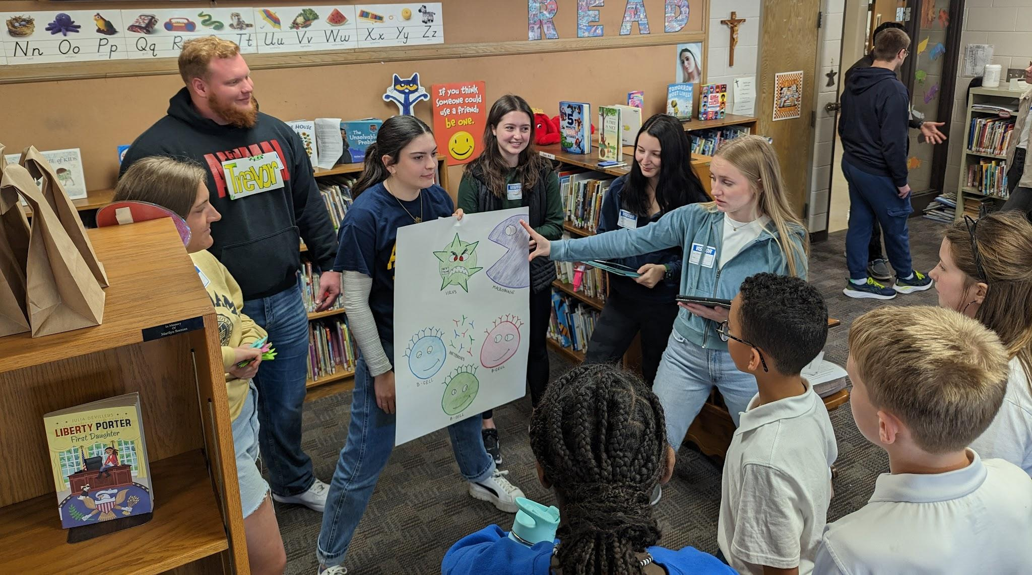
Incorporate the Creation and Teaching of Lessons for K-12 Students into Your College Course
Dr. Jennifer A. A. Gubbels
Associate Professor of Biology
Augustana University

Slide 2
Outline
Examples of this service learning activity in two upper level courses
Benefits of this activity
Specific steps for how to develop this activity in your own course
Questions
Brainstorm your own activity in your course

Slide 3
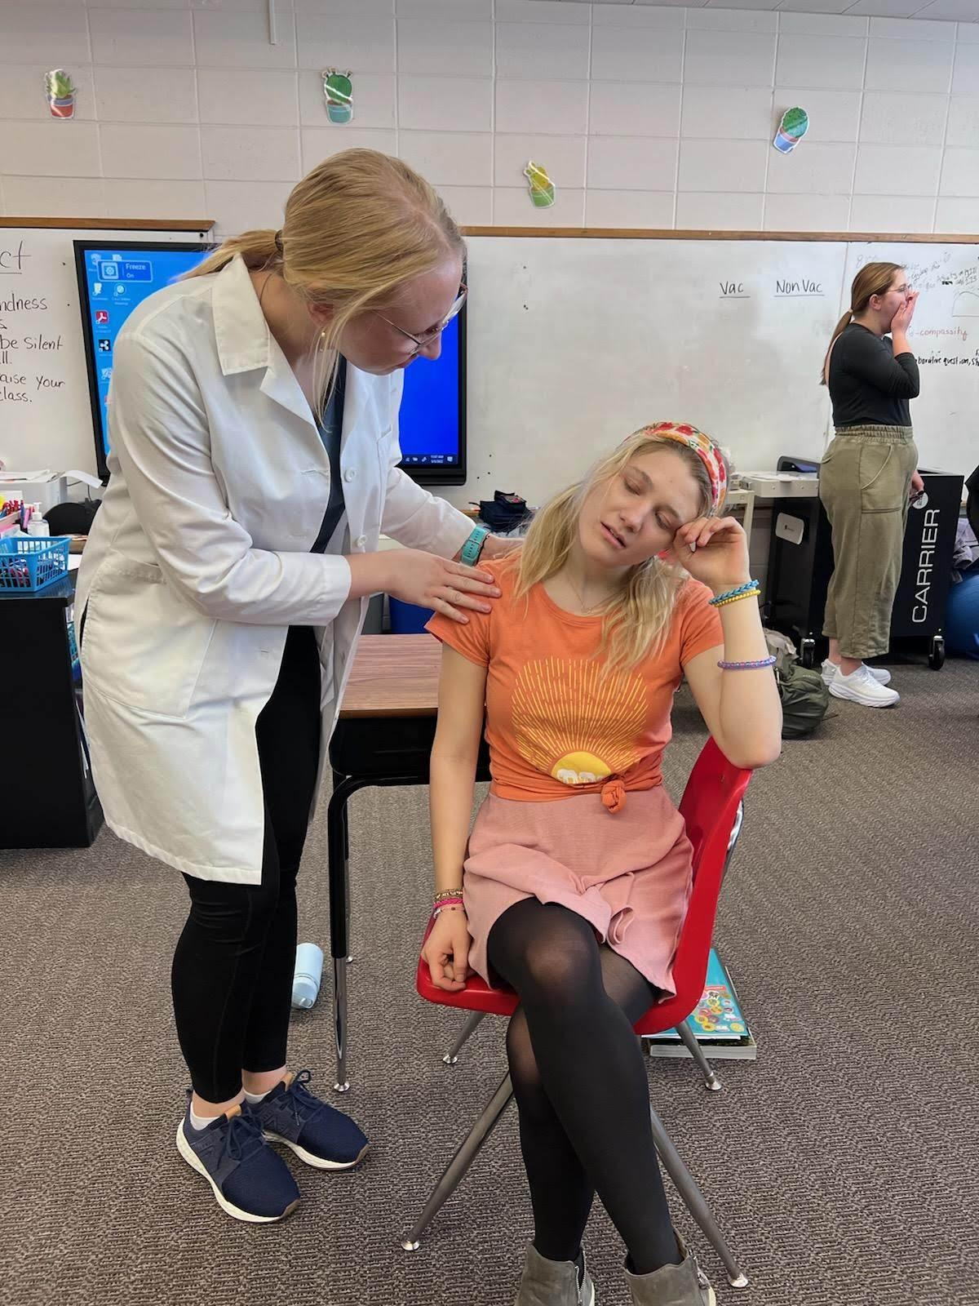
Two examples from upper-level courses
Advanced Human Physiology: The Five Senses Exploration Rotation
5 groups, elementary students rotate through
Intro, 1-2 objectives, hands-on activity, visual aid, assessment
Reflection
Immunology: The Flu Shot Skit
5 groups, one group is responsible for opening and closing skit
Other 4 groups assigned parts of the immune system: B cells, T cells, Physical barriers, Phagocytes
Intro, objectives, hands-on activity, visual aid, assessment
Reflection
Notes:
each lab group develops a lesson on one of the 5 senses. They must have an introduction, a hands-on activity, a visual aid, and an assessment tool. The elementary students are broken into 5 groups and rotate through each station (12 or so minutes each) in an hour long period.
There are 5 groups of college students. One group is responsible for an opening and closing skit to tell the story of a girl who got the flu who didn’t get the flu shot. The rest of the groups are each responsible for a part of the immune system: physical defenses, T cell, B cells, and phagocytes. Each group needs an introduction, a hands-on activity, and a visual aid. After the opening skit, the elementary students rotate around to each of the immune system parts until it is time for the closing skit, where a group

Slide 4
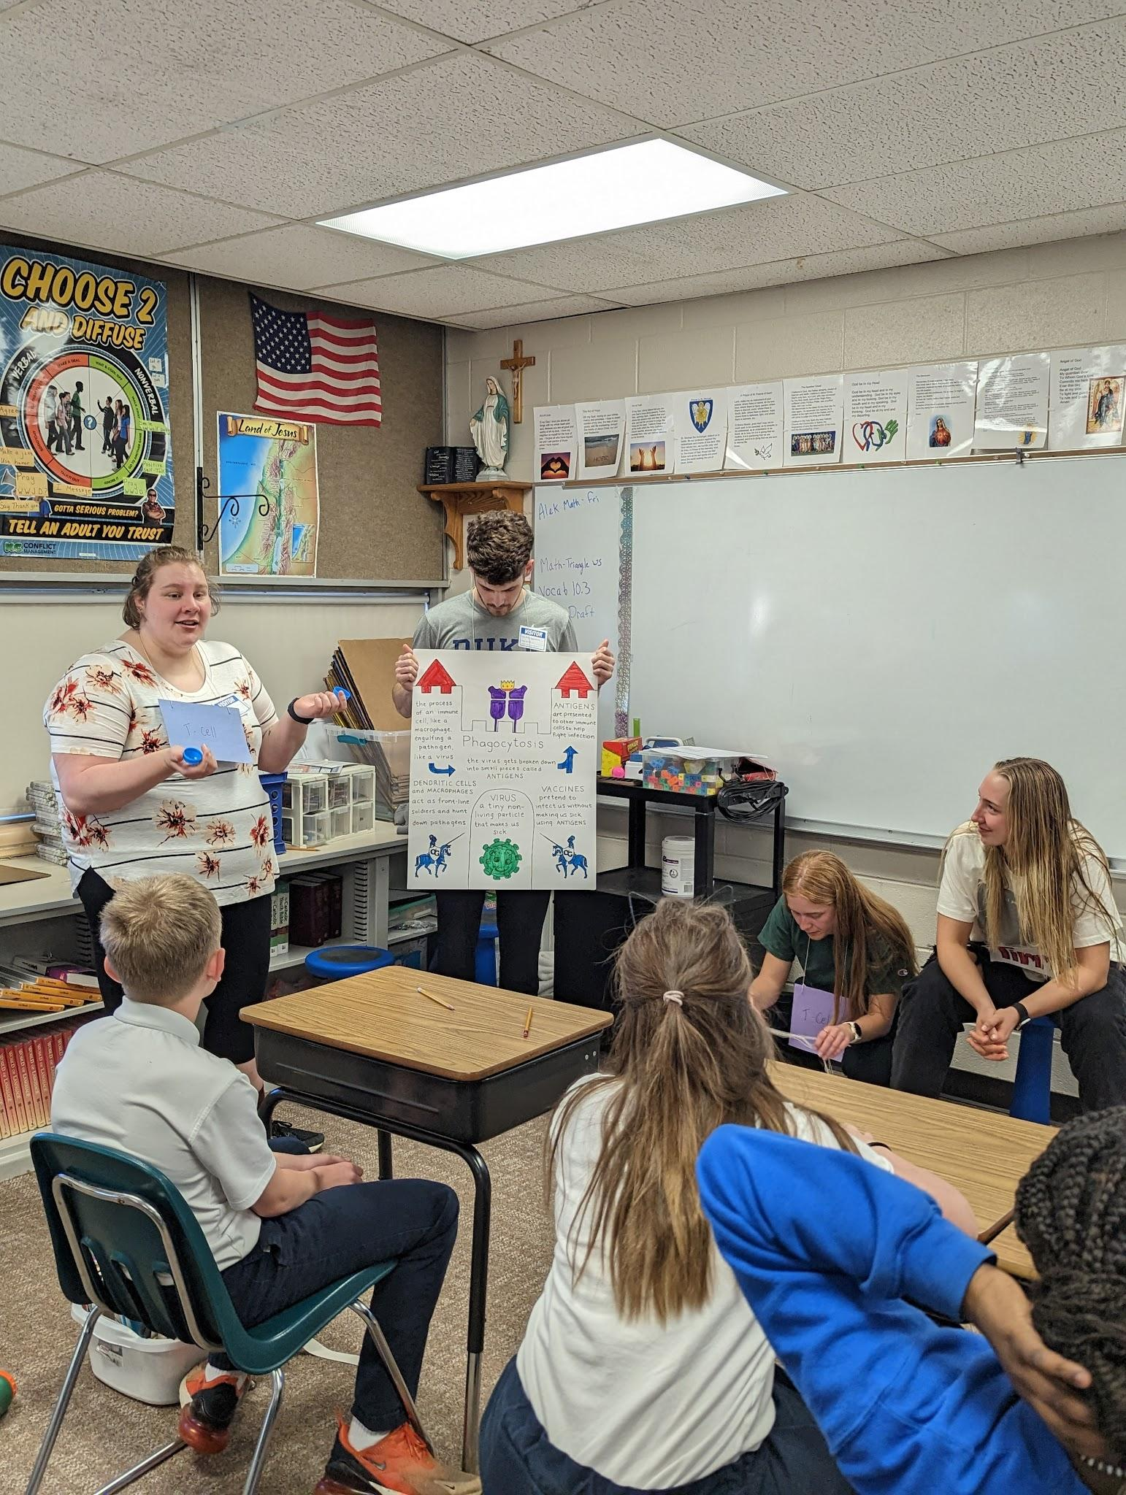
Benefits of this service learning activity for DE&I and more!
Increases college students’ sense of scientific identity
Developing a lesson gives them practice and appreciation for teaching–helpful for many careers
Encourages development of skills normally not assessed–communication, artistry, creativity, acting, working with children
Gets students out into the community, working with students of diverse backgrounds, establishes precedent for later community and school involvement
College students become role models for K-12 students

Slide 5
Incorporating Lesson Creation into a Course
What do you want them to learn that enhances the learning that is already happening in the classroom?
What kind of format of presentation to the K12 students will you choose to facilitate that learning?
How will you prepare the students for the activity?
How will you promote reflection about the learning that occurred?
Go one step further and think about a research question, how to gather data, and then publish your activity!
Notes:
Tie in your service to a theme from your course. Pinpoint some objectives that you want them to learn, and repeat them often, before the activity, while preparing for hte activity, and after the activity.

Slide 6
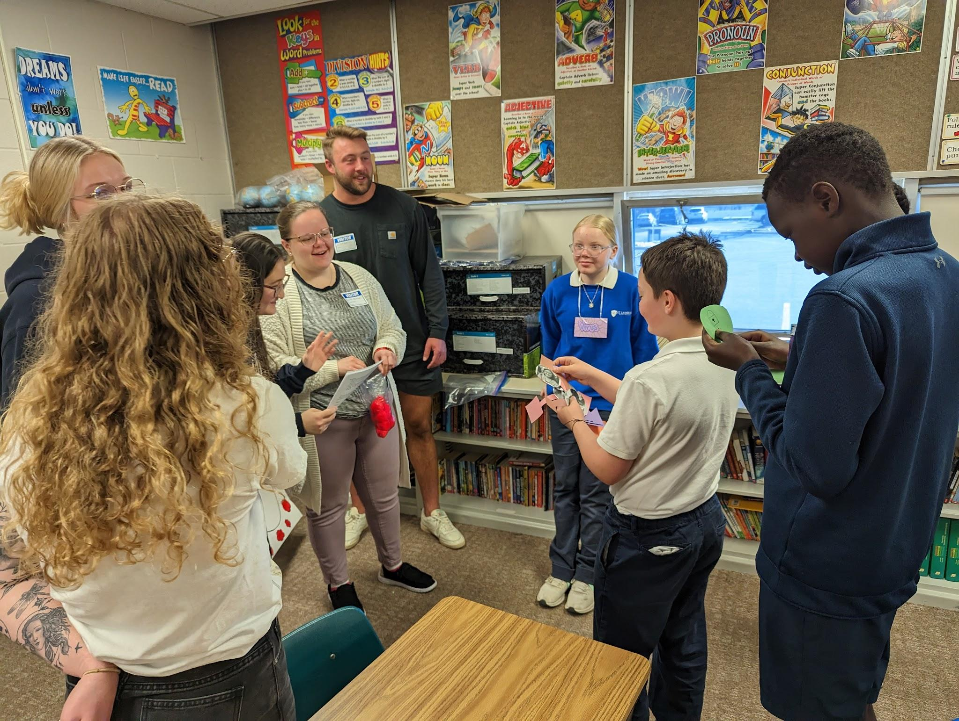
What do you want them to learn that enhances the learning that is already happening in the classroom?
Choose a topic that complements what you are learning in the classroom
A topic that lends itself well to hand-on activities
Topics that can be divided into parts are helpful for this model
Notes:
Used it as a way to promote my own way of teaching.

Slide 7
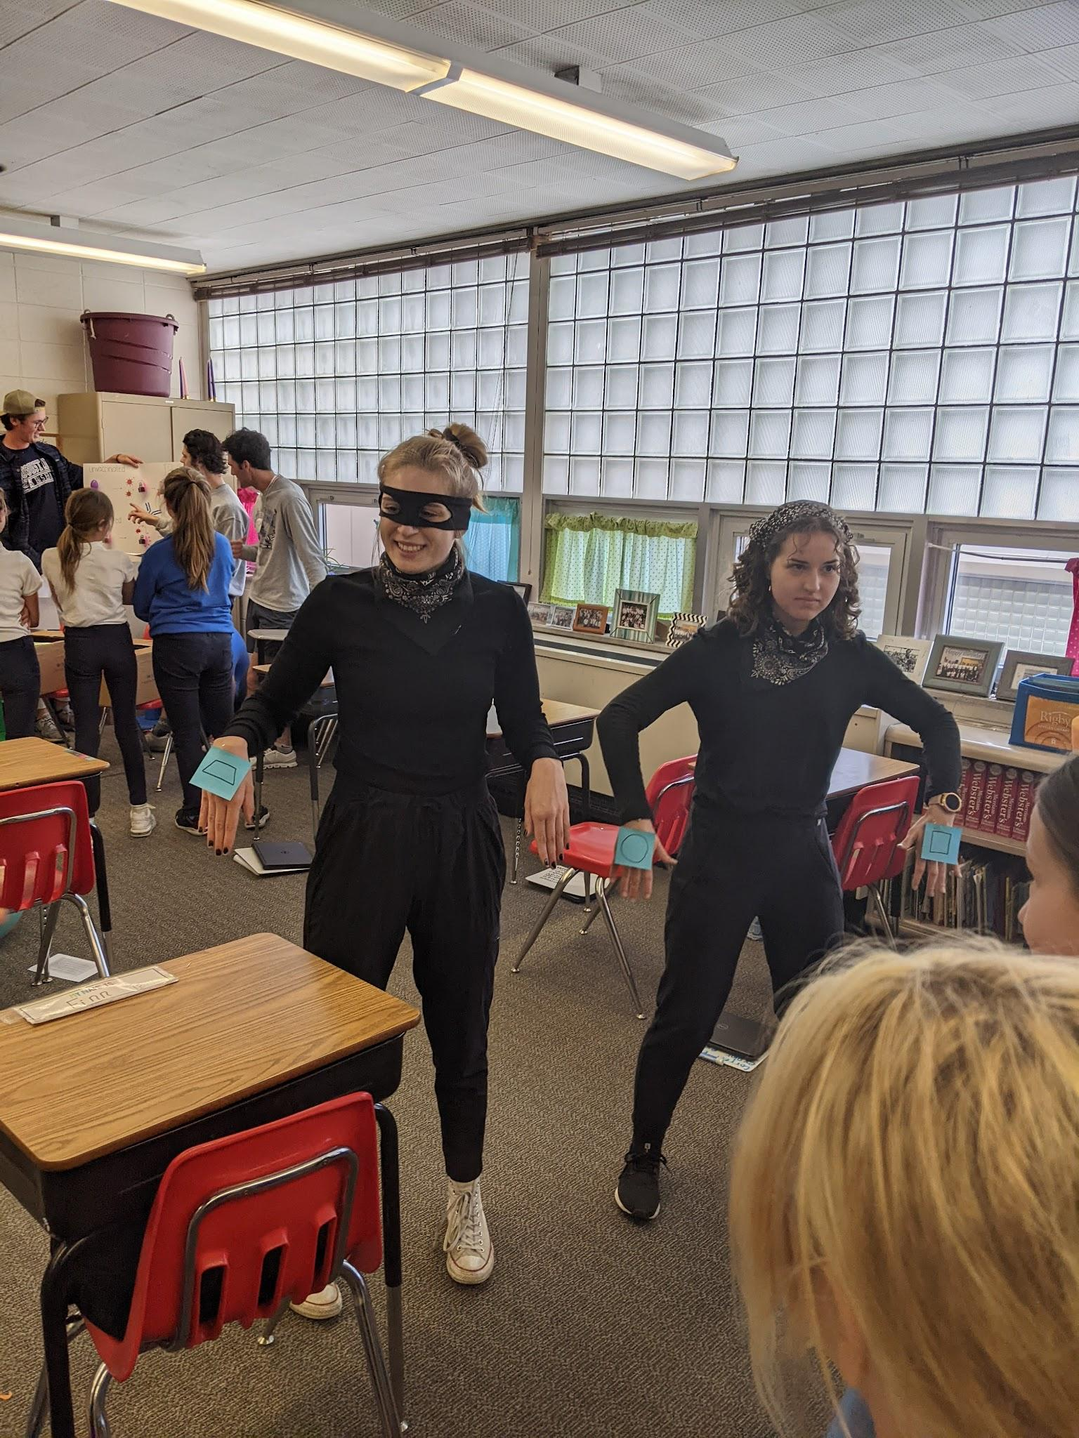
2. Choose the activity
Logistics, logistics, logistics
Contact teachers (can use your Education colleagues to help with this!)
Scheduling towards the end of the semester
Arrange transportation–carpool
Figuring out equal work for groups can be challenging
Notes:
Ask the teacher– how many students are in the class? Can they break them up into appropriate groups for your activity? Can you have four groups in one classroom? Are there other classrooms you can use? How much time do you have?

Slide 8
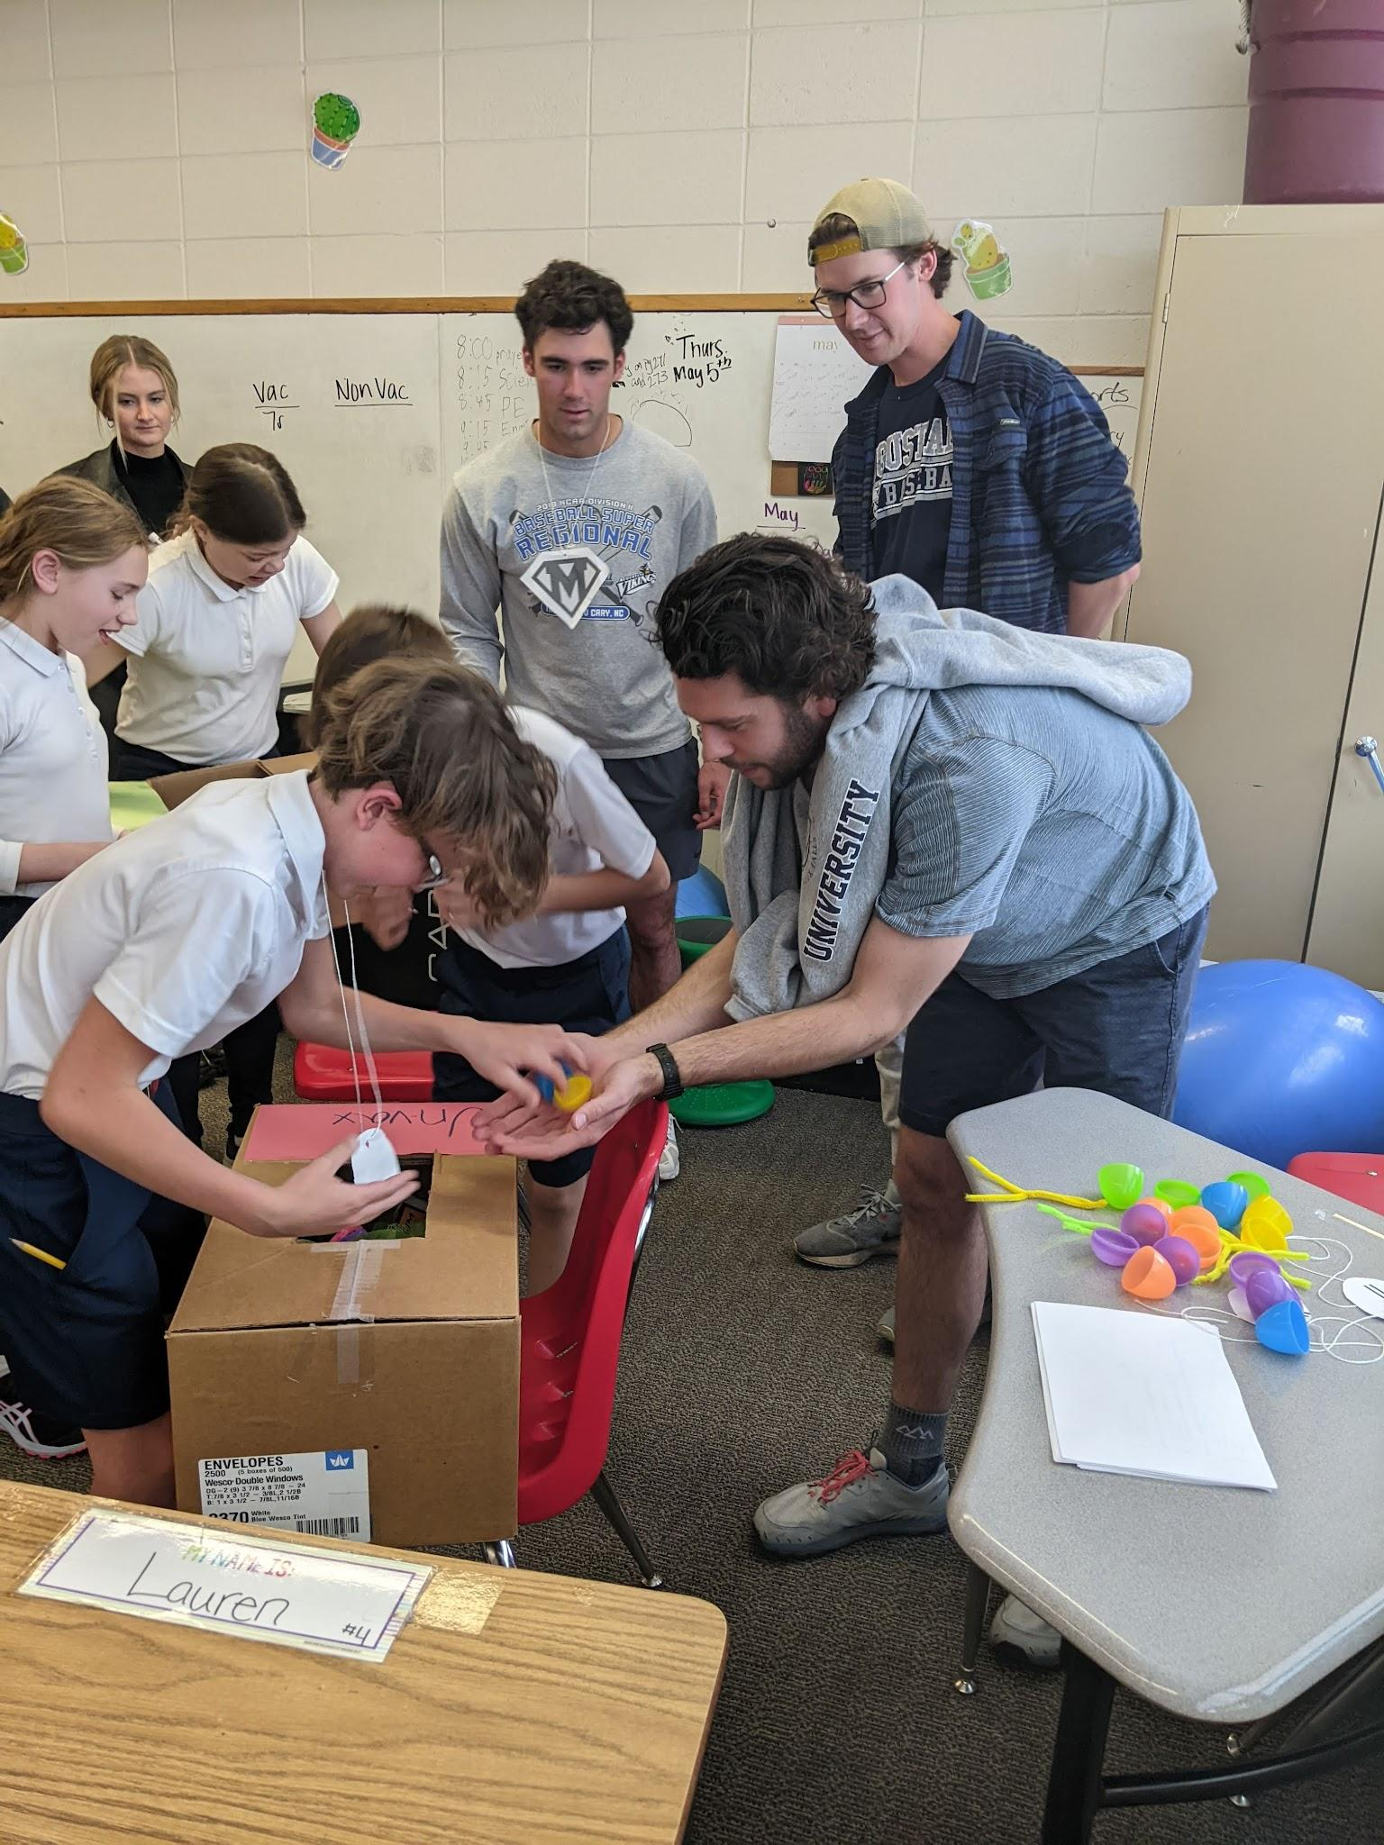
3. Prepare the students
1 part of a lab period to make their lesson
Another part of a lab period as “dress rehearsal”
One lab period for going to the school and presenting.
Notes:
I have a few boxes of supplies that I have kept over the years that they can use for props. Have a small budget if they need to buy something.

Slide 9
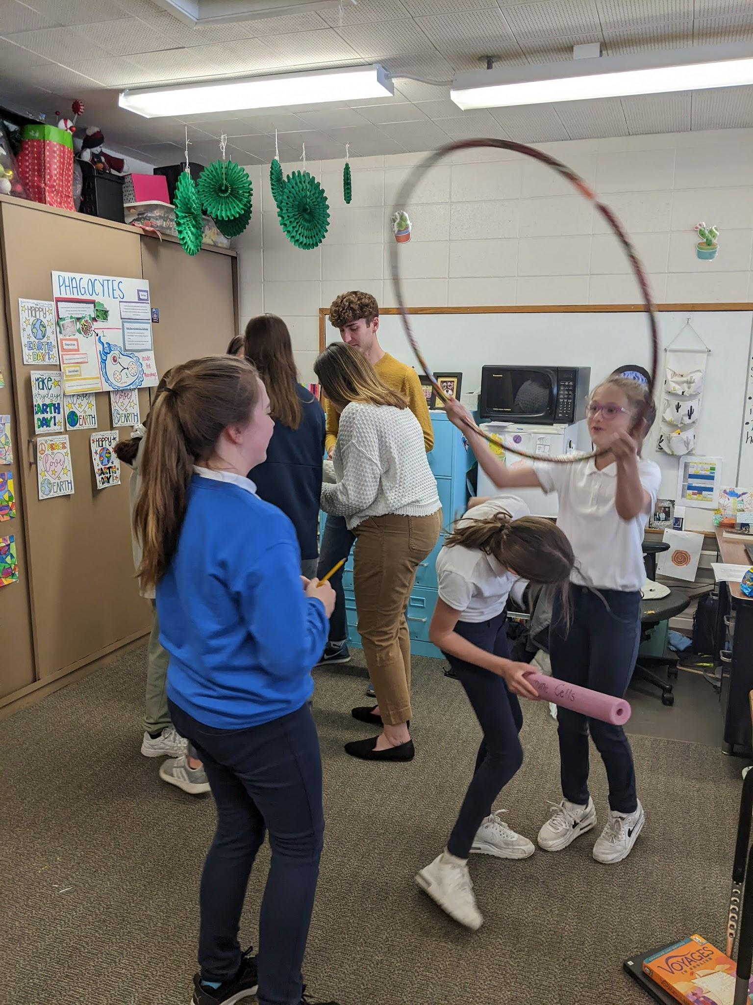
4. Promote Reflection
Outreach Summary
1-2 sentence introduction about what you did.
1 page data summary and answer the following questions:
1. What went well?
2. What would you do differently if you did it again?
3. What did your students learn? (summarize data here)
4. What did YOU learn?
5. Any anecdotes you would like to share?
Notes:
What happened the one year I didn’t do this.

Slide 10
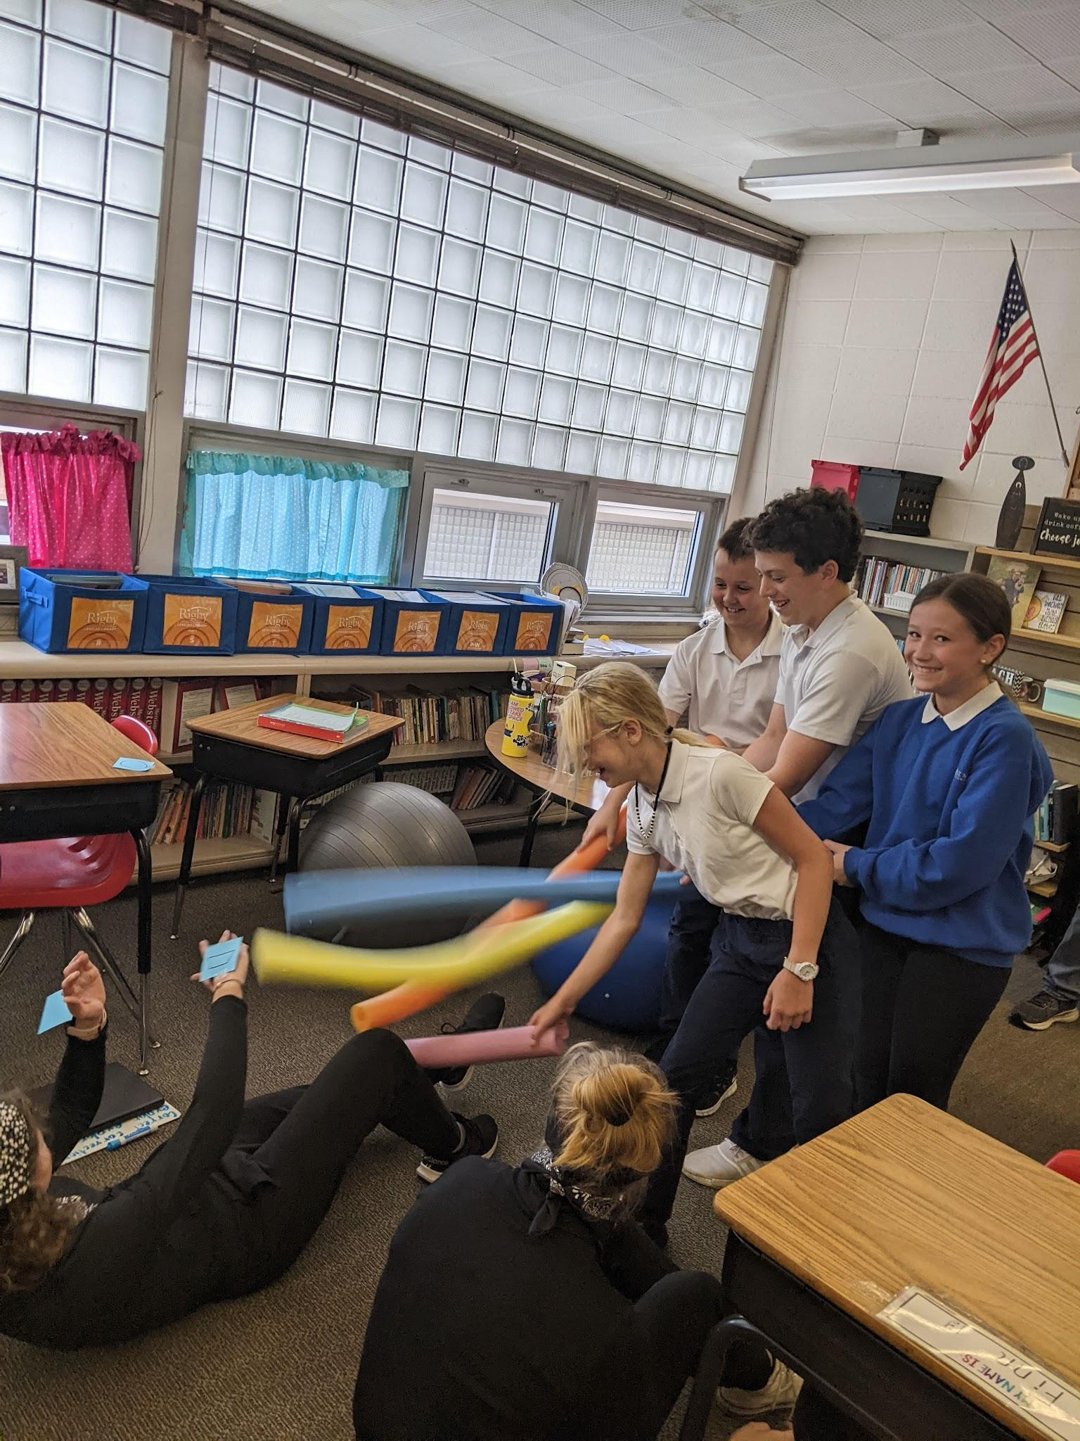
5. Publish your activity!
Creating and Teaching Science Lessons in K12 Schools Increases Undergraduate Students’ Science Identity
Journal of Microbiology and Biology Education
Jennifer A. A. Gubbels and Seasson P. Vitiello

Slide 11
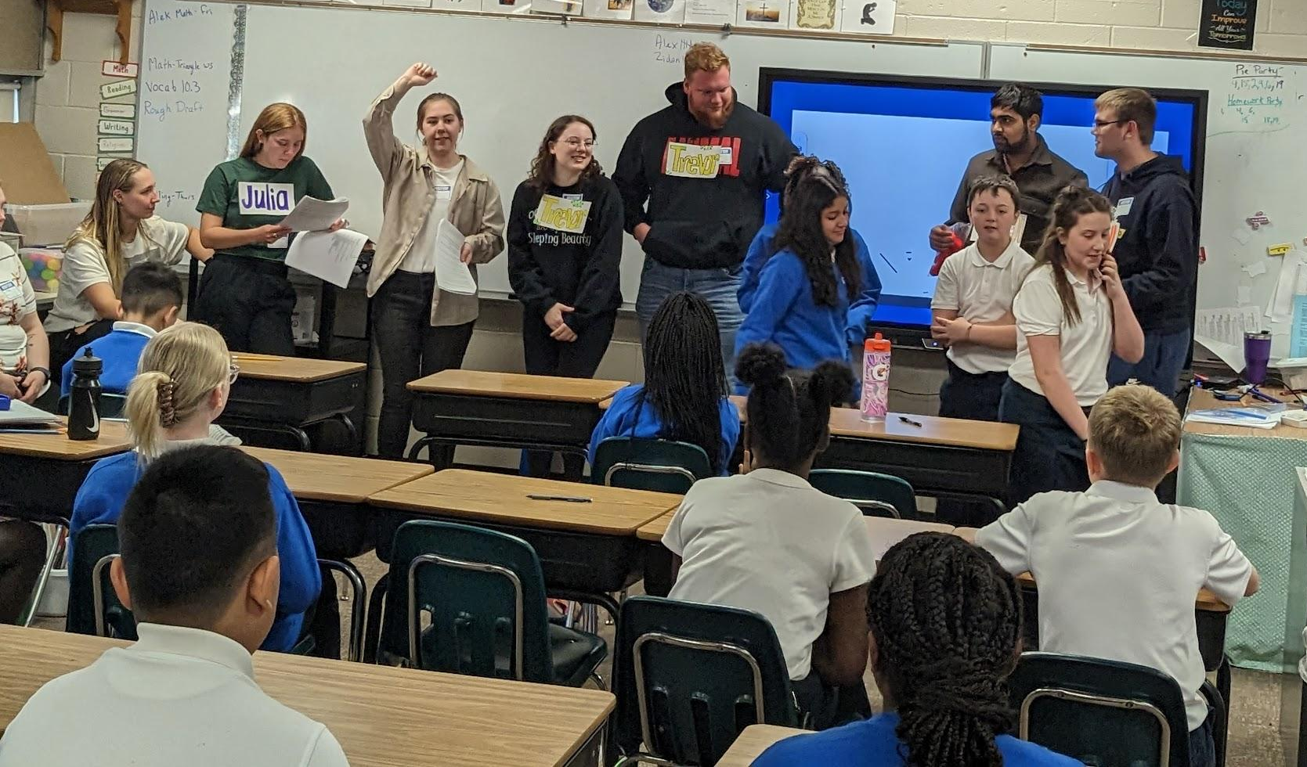
Questions?

Slide 12
Take a few minutes to. . .
Write down a class for which you could envision incorporating a lesson for elementary students.
Write down a topic that you can envision your students exploring by creating a lesson for elementary or high school students
What kind of hands-on activities can you imagine the students creating?

