Slide 1
Elevate and Educate: Key Strategies for Effective Teaching and Learning
Dr. Megan Fixen
Kelly Hendershot
Katelynn Albers

Slide 2
What?
Teachers must learn to use a variety of teaching practices (Davis & Palincsar, 2023).
High-leverage practices are designed to improve the ability of students to reach goals, and support students in learning academic concepts.
Effective high- leverage practices may enhance student outcomes (McLeskey et al. 2022).

Slide 3
Why?
Promotes higher levels of student learning and understanding over other teaching practices (Hlas, 2012).
Student learning depends on the interactions of teachers and students (Hlas, 2012).
Encourages students to work together using problem-solving skills (Hlas, 2012).
Active learning increases student engagement and promotes student-teacher relationships (Collaco, 2017)

Slide 4
How?
Strategy 1: Increase student engagement- several active learning strategies will be outlined that will help increase interaction and engagement.
Strategy 2: Strengthen faculty relationships and assess student understanding- an outline of a class starter that increases discussion and results in timely feedback on course elements will be presented.
Strategy 3- Enhance critical thinking and communication skills- an outline of how to effectively use case studies in the classroom will be provided.

Slide 5
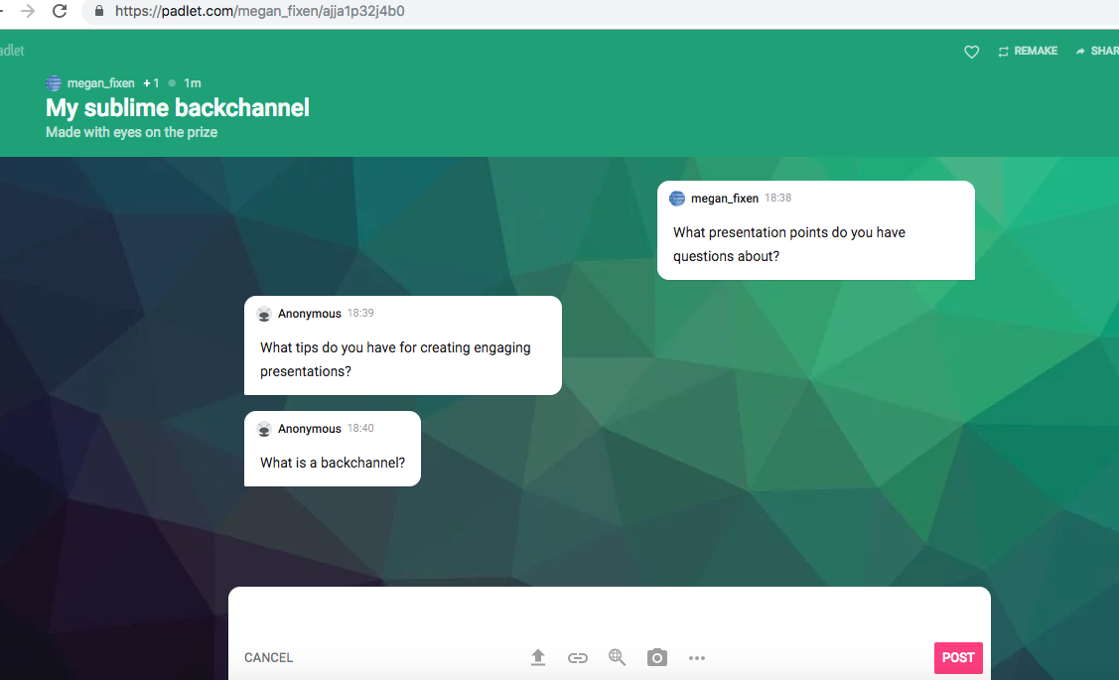
Strategy 1: Increase student engagement
Padlet- Tool to create a back channel

Slide 6
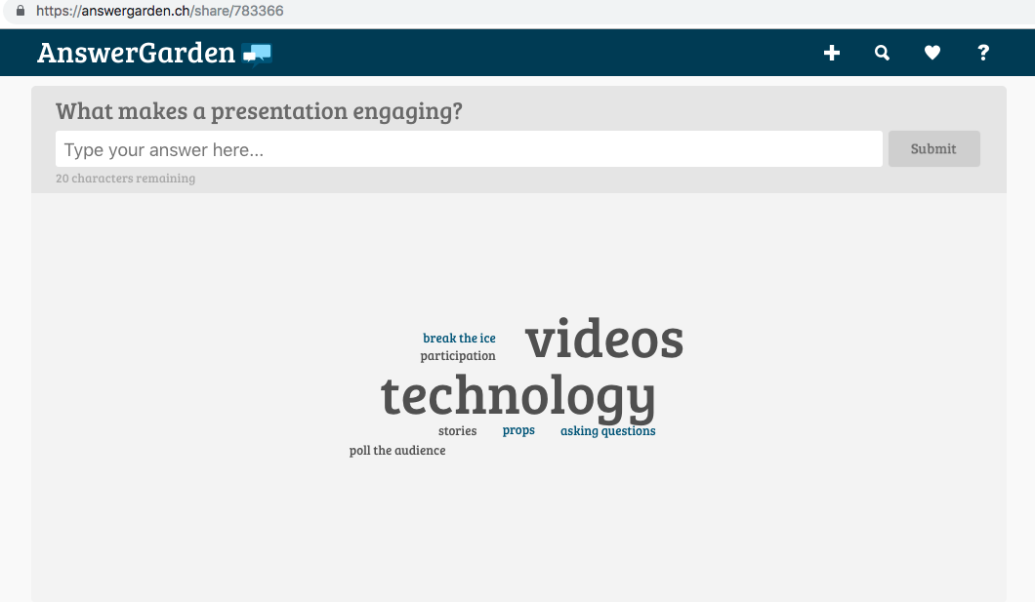
Strategy 1: Increase Student Engagement
Answer Garden- Used for online brainstorming & real time feedback

Slide 7
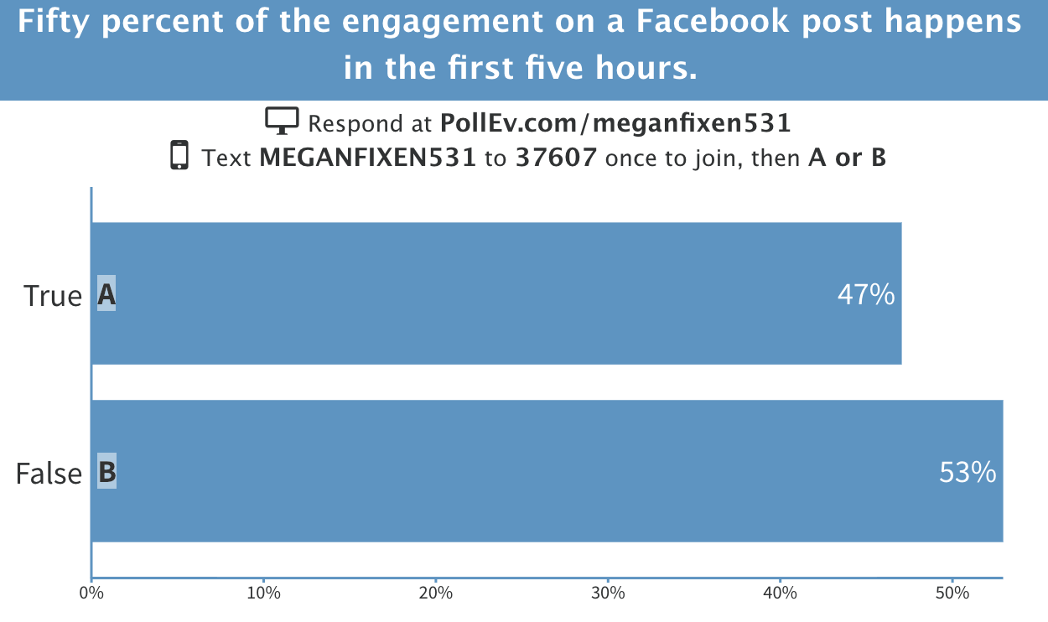
Strategy 1: Increase Student Engagement
Poll Everywhere- Real time audience engagement

Slide 8
Strategy 2: Strengthen faculty relationships and assess student understanding
Provide notecard to each student at beginning of class
Present an informal class starter question and require students to provide a written response
Ask questions on course material throughout class and require students to provide a written response before sharing with small groups and the entire class (Think/Write/Share)
Review feedback relating to all questions posed
Interpersonal relationship built with students through card feedback, as well as, quick daily formative assessments to monitor learning and diagnose difficult content for re-teaching or further enrichment.

Slide 9
Strategy 3: Enhancing Critical Thinking and Communication Skills
Provide case study with questions in advance for students to prepare
Provide resources to consider for critical thinking
Require classroom attendance and participation for verbal communication
Encourage everyone to participate and share ideas
Take notes during discussion
Require document submission of answers for written communication

Slide 10
Discussion Time
Questions?

Slide 11
References
Collaco, C.M. (2017). Increasing Student Engagement in Higher Education. Journal of Higher Education and Practice, 17(4), 25-31.
Davis, E. A., & Palincsar, A. S. (2023). Engagement in high‐leverage science teaching practices among novice elementary teachers. Science Education, 107(2), 291-332.
Hlas, A.C. and Hlas, C.S. (2012), A Review of High-Leverage Teaching Practices: Making Connections Between Mathematics and Foreign Languages. Foreign Language Annals, 45: s76-s97.
McLeskey, J., Maheady, L., Billingsley, B., Brownell, M. T., & Lewis, T. J. (Eds.). (2022). High leverage practices for inclusive classrooms. Routledge.

Slide 12
Thank you

