Slide 1
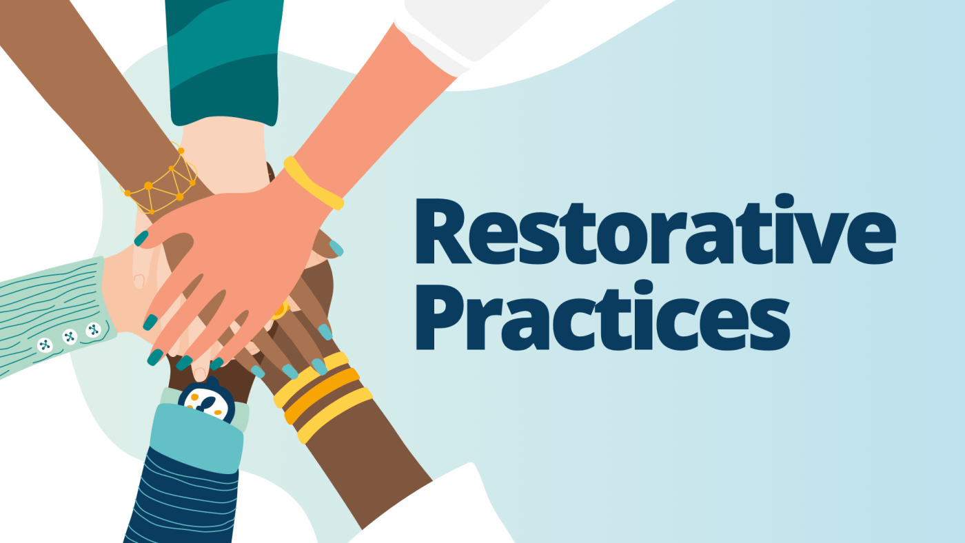
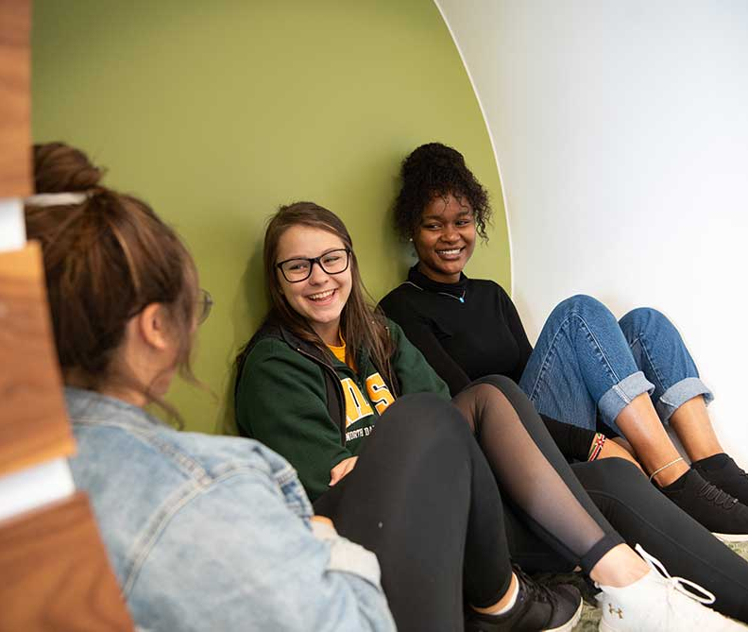
Restorative Practices in the Higher Education Setting Matt Diischer, Assistant Dean of Students

Slide 2
Goals For Presentation
Provide brief history of Restorative practices
Historical
Modern
Share overview of how to conduct a restorative talking circle
Provide examples of potential application by educators and administrators

Slide 3
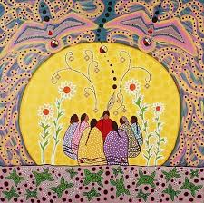
Brief History of Restorative Justice
Indigenous and Afro-Indigenous Roots
Community-orientated practices for dealing with conflicts
“Deep, interconnected, communal understanding of justice” (Evans & Vaandering)
Circle dialogue as a foundation
Connection
A restoration of relationships
Historical
Notes:
Most tribal-based cultures worldwide have preserved community-oriented practices for resolving crimes and conflicts that share many components with restorative justice.
These include the voicing of impacts to the community and the reintegration of the offender back into the community.
They also include the power of storytelling and the respected wisdom of elders. Many of these traditions, though lost through the era of colonialization, have been revitalized in recent decades as a result of the international restorative justice movement.

Slide 4
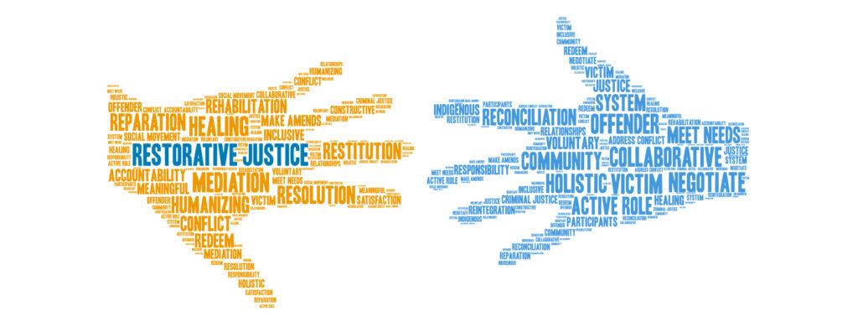
Brief History of Restorative Justice
Modern
Criminal System – Victim Offender Reconciliation Programs
1974 – Elmira Case – meet with victims, provide restitution
Diversion programs
Recognized by America Bar Association in 1994, United Nations in 1999
Picture - https://hindsda.com/smart-justice/restorative-justice-division/
Notes:
The 1974 Elmira Case. An unprecedented justice process in Kitchner, Ontario, served as a significant catalyst for the modern rise of restorative justice in North America. Two older teenagers, under the influence of alcohol, destroyed 22 different properties in a rural town. Mennonite Central Committee workers Mark Yantzi and Dave Worth asked Judge McConnell if the responsible youth could make direct apology and reparation to all impacted parties. They were allowed meet every harmed party at their front door. Out of this case, the Victim Offender Reconciliation Program (VORP) mediation model developed and spread through North American Mennonite networks, starting first in Elkhart, Indiana (1978).
Circles and Conferencing Rise in the 1980s and 1990s. As the mediation model began to spread, Judge Barry Stuart of the Yukon Territorial Court adapted the Sentencing Circle as a way to honor older indigenous traditions of native communities. Meanwhile, Maori practices in New Zealand developed the facilitated Family Group Conference model to address all levels of crime with the help of family members and support people.
Most tribal-based cultures worldwide have preserved community-oriented practices for resolving crimes and conflicts that share many components with restorative justice.
These include the voicing of impacts to the community and the reintegration of the offender back into the community.
They also include the power of storytelling and the respected wisdom of elders. Many of these traditions, though lost through the era of colonialization, have been revitalized in recent decades as a result of the international restorative justice movement.

Slide 5
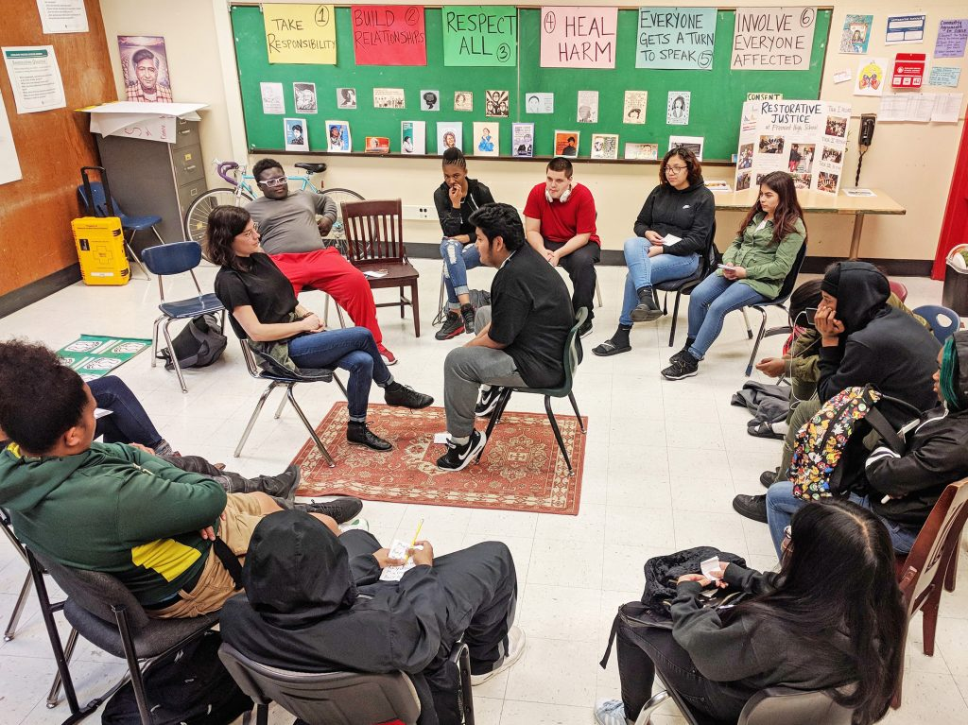
Brief History of Restorative Justice
Modern
Expansion into Education
Teachers/principals/counselors adapting within school contexts
Minnesota as frontrunner of restorative justice in education
New restorative justice initiatives after Zero Tolerance
2014 – DOJ/DOE Joint Statement – overuse of exclusionary behavior, recommendation of alternatives like restorative practices
Picture - https://edsource.org/2018/the-rise-of-restorative-justice-in-california-schools-brings-promise-controversy/597393
Notes:
The 1974 Elmira Case. An unprecedented justice process in Kitchner, Ontario, served as a significant catalyst for the modern rise of restorative justice in North America. Two older teenagers, under the influence of alcohol, destroyed 22 different properties in a rural town. Mennonite Central Committee workers Mark Yantzi and Dave Worth asked Judge McConnell if the responsible youth could make direct apology and reparation to all impacted parties. They were allowed meet every harmed party at their front door. Out of this case, the Victim Offender Reconciliation Program (VORP) mediation model developed and spread through North American Mennonite networks, starting first in Elkhart, Indiana (1978).
Circles and Conferencing Rise in the 1980s and 1990s. As the mediation model began to spread, Judge Barry Stuart of the Yukon Territorial Court adapted the Sentencing Circle as a way to honor older indigenous traditions of native communities. Meanwhile, Maori practices in New Zealand developed the facilitated Family Group Conference model to address all levels of crime with the help of family members and support people.
Most tribal-based cultures worldwide have preserved community-oriented practices for resolving crimes and conflicts that share many components with restorative justice.
These include the voicing of impacts to the community and the reintegration of the offender back into the community.
They also include the power of storytelling and the respected wisdom of elders. Many of these traditions, though lost through the era of colonialization, have been revitalized in recent decades as a result of the international restorative justice movement.

Slide 6
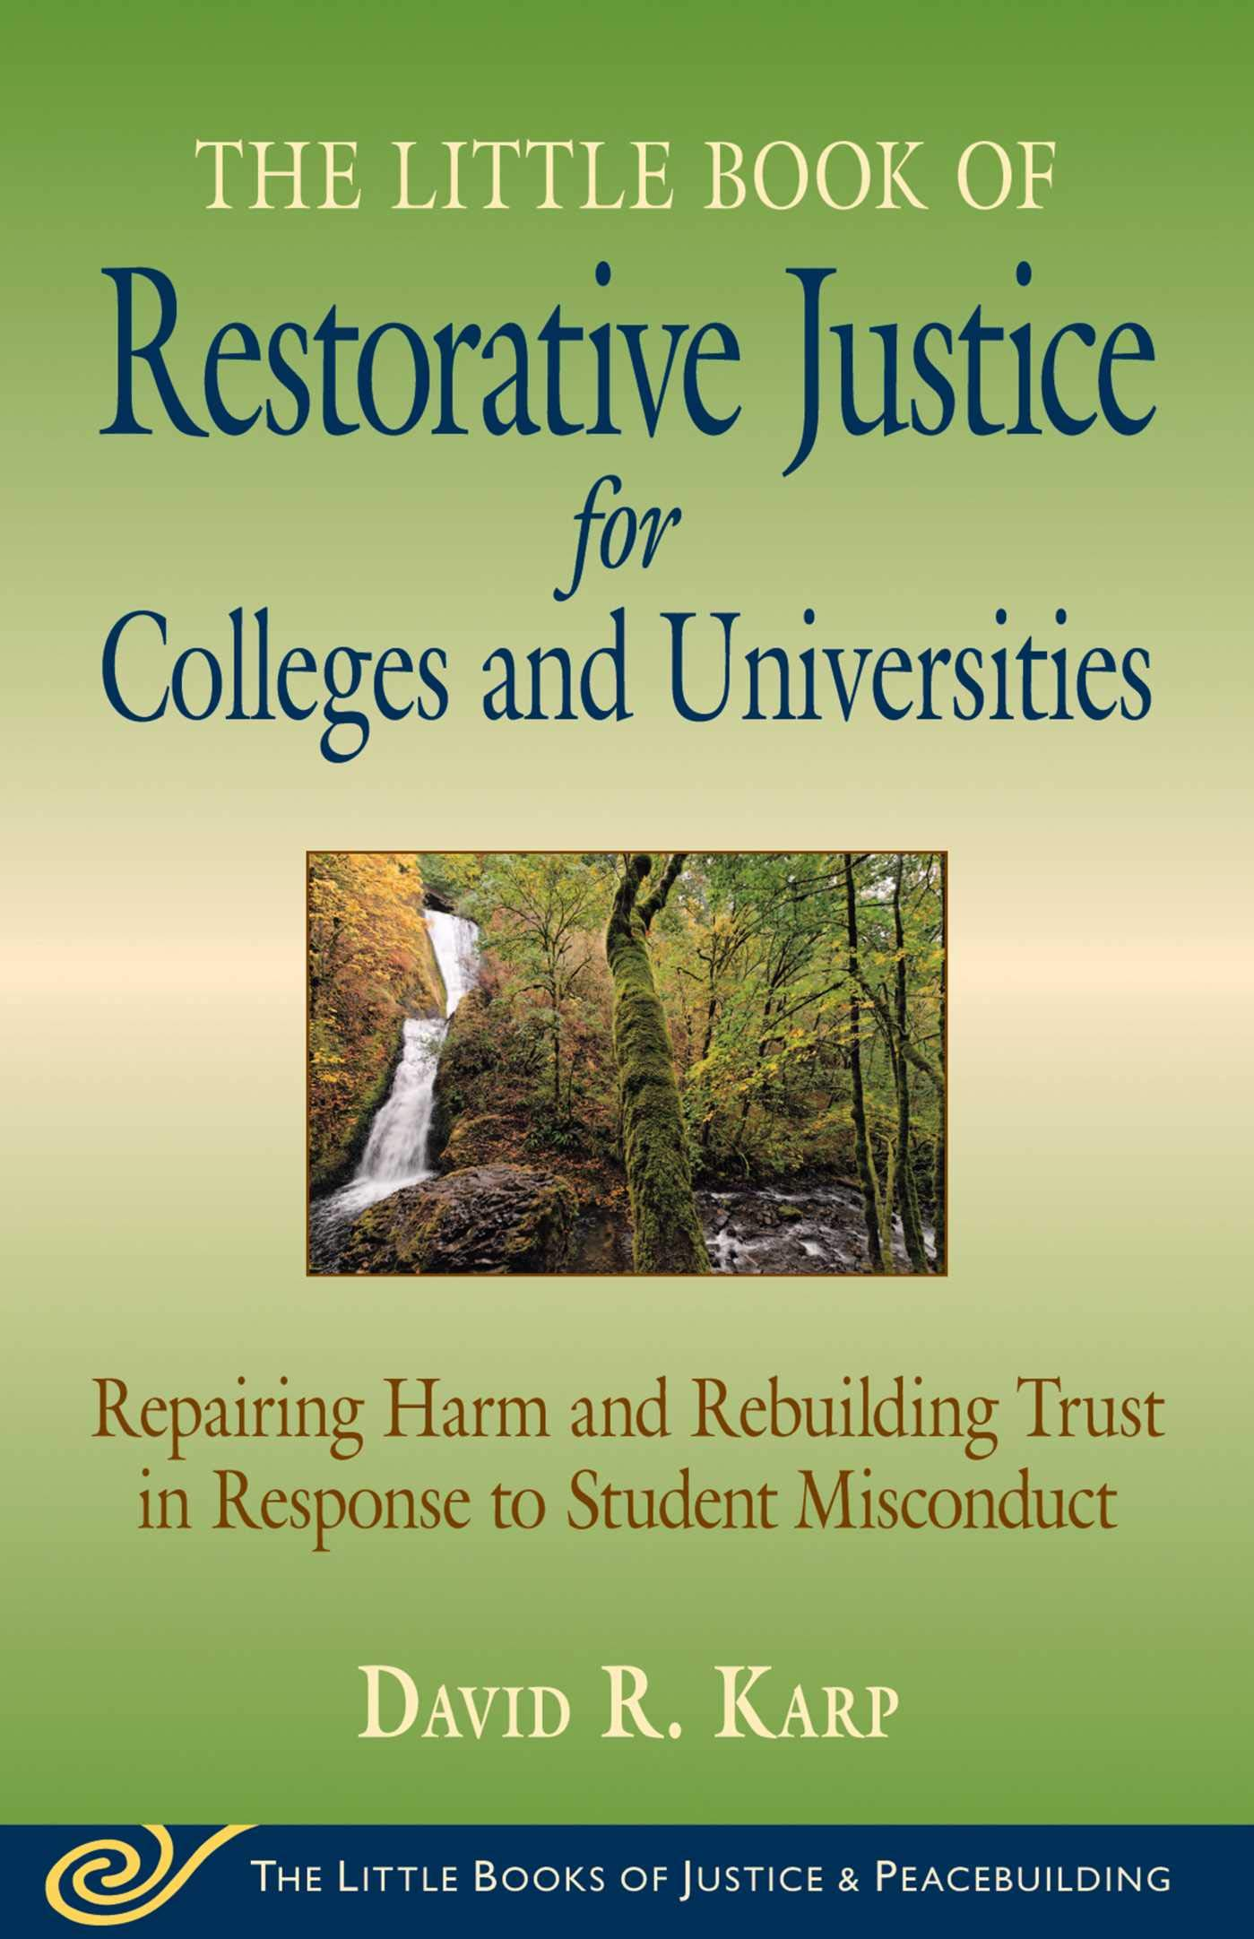
Brief History of Restorative Justice in Higher Education
University of Colorado-Boulder
1998
Significant impact
University of Michigan
Take direct responsibility for what they did
Offer an apology
Opportunity for diversion from traditional judicial system
University of San Diego
“Was an amazing experience and opportunity for me to reflect on my action. I am really grateful that I was given the chance to apologize and speak with affected parties!”

Slide 7
Components of Restorative Justice in Education
Notes:
Foundational Tenet – People are worthy and relational
Key Values of Respect Dignity and Mutual Concern
Three core components – Nurturing Healthy Relationships, Repairing Harm and Transforming Conflict, Creating Just and Equitable Learning Environements

Slide 8
Types of Restorative Practices:
1. Restorative Hearing. Respondent and Conduct officer addressing a misconduct or violation incident, and restoratively addressing harms and obligations to make things right.
2. Restorative Board. Respondent and a group of trained students, faculty and staff who address Quality of Life violations, typically in cases without direct victims but clear impacts to the community.
3. Restorative Conference. Responsible party, impacted parties, support people, and facilitators who address harms or crimes after routine preparation meetings; consensual reparation agreements are written, signed, and tracked by the program.
4. Restorative Circle. Same participants as in Conferencing plus community members; suited for larger numbers, addressing harms that may involve multiple parties on either side; well-suited for ongoing meetings for both support and accountability; can weave in new participants.
5. Restorative Dialogue. Designed for situations involving mutual responsibility (alcohol brawls, etc.) and mutual impact. Support people and community members can be included. Plans for preventing similar future situations are normative.

Slide 9
Our Focus:
Restorative Circle. Same participants as in Conferencing plus community members; suited for larger numbers, addressing harms that may involve multiple parties on either side; well-suited for ongoing meetings for both support and accountability; can weave in new participants.
Picture - https://www.talkingcircles.in/

Slide 10
Circles in Practice:
Elements:
Set-Up – Participants sit in circle, meaningful objects potentially in middle
Ceremony – Intentional centering or ceremony at opening and closing to mark the space
Talking Piece – An object passed around the group, and only the holder may speak
Undivided attention and deep listening from others – “Listening is not a passive activity”
Facilitator(s)/Keeper(s) – Trained participant(s) who monitor space, ensures participants feel safe to speak openly and honestly, may provide prompts of questions
Shared Creation of Guidelines for Space – Reminders about shared commitments for a safe space for difficult conversation
Consensus Decision-Making – Each participant (whether enthusiastic or not) is willing to live with decisions and support implementation

Slide 11
Types of Circles:
Tier 3 – Circles of Support and Accountability
Tier 2 – Community Concern Circles
Tier 1 – Community-Building Circles
Notes:
Tier 1 – Get to know you cirlces, beginning of the year circles
Tier 2 – Escalated roommate/classmate conflicts, tough conversations about difficult subjects, responding to harm in the community
Tier 3 – examples like Suspension Reentry Circle of Support

Slide 12
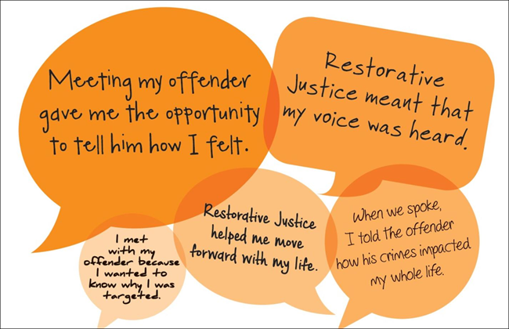
RJE Response Types
Proactive
Building relationships and developing community
Welcome Week!/Beginning of Class
Core Values
Coming Out Week
Stress around the Holidays
Guest Speaker Response
Responsive
Repairing harm and restoring relationships
Harm to the community but inability to hold an individual(s) responsible
Impactful event on campus
Elevated conflicts (personal, community)
Damage to the community
Notes:
Restorative Practices
The aim of restorative practices is to develop community and to manage conflict and tensions by repairing harm and building relationships. This practice uses both proactive (building relationships and developing community) and reactive (repairing harm and restoring relationships) approaches. Restorative practices can be used in a variety of settings such as the classroom, residence halls, team meeting, etc..
Restorative practice is based on the understanding that restoring a relationship, after both parties have been fairly heard and mutual respect has been built, improves the healing of the parties or whole communities.
Schools can use restorative circles for building community and addressing challenging behavior. “Harm Circles” address harm caused to the community by a student or students.
Proactive Restorative Practice Examples
Conflict for all staff/faculty
Use circle for group decision making
Transfer student circles
International student circles
FSL chapter circles
Teach RA’s RP techniques
RA floor circles
Circles in Welcome Week
Use in We Take a Stand training
Peer education (x2) & tie with PCCW
Use in health promotion efforts
Staff/department circles/check-in’s during designated times
Include RP and DEI in hiring & tenure practices
Train people to use RP at the departmental level
Shared RP at onboarding for all faculty & staff that mirrors expectations of students
Implement in staff trainings to build connections
Implement in classrooms
Education cabinet/administration in RPN
Educate student on the processes available
Introduce philosophy/values earlier in the college search process
Encourage staff/faculty to be more present outside of the classroom/office
Informal conversation circles w/student, staff, and faculty of different experiences
Use within PCCW and PCDIR committees
Community building opportunities for place-bound students
Use in open forum discussions
-Reactive RP
Conflict situations involving faculty, staff, and students
Use values-based RP for supervised probation
Identify specific populations harmed in order to support
Distribute victim statements to develop empathy in cases of harm
Circles to discuss community harm

Slide 13
NDSU Restorative Practices
Participate/Encourage Others!
Come to a Talking Circle!
https://myndsu.ndsu.edu/organization/rpn
Request a Talking Circle!
https://ndstate.co1.qualtrics.com/jfe/form/SV_6tjU5Vlxt5oVT2m
Email us for more info or ?’s!
ndsu.rpn@ndsu.edu

Slide 14
NDSU Restorative Practices
Consider Getting Involved!
Join us for our Restorative Practices Network meetings!
Each Month
Get trained as a Circle Keeper!
Start with Tier 1 circles and gain experience!

Slide 15
References
Boyes-Watson, C., & Pranis, K. (2015). Circle forward : building a restorative school community. Living Justice Press.
Evans, K., & Vaandering, D. (2022). Little Book of Restorative Justice in Education: Fostering Responsibility, Healing, and Hope in Schools (2nd ed.) [Review of Little Book of Restorative Justice in Education: Fostering Responsibility, Healing, and Hope in Schools]. Good Books.
‌Karp, D. R., & Armour, M. P. (2019). The little book of restorative justice for colleges and universities : repairing harm and rebuilding trust in response to student misconduct. Good Books.
‌Pranis, K. (2005). The Little Book of Circle Processes [Review of The Little Book of Circle Processes]. Good Books.

Slide 16
Thank you!
Questions?
Matt Diischer, Assistant Dean of Students
Matt.Diischer@ndsu.edu
701-231-1825

