Slide 1
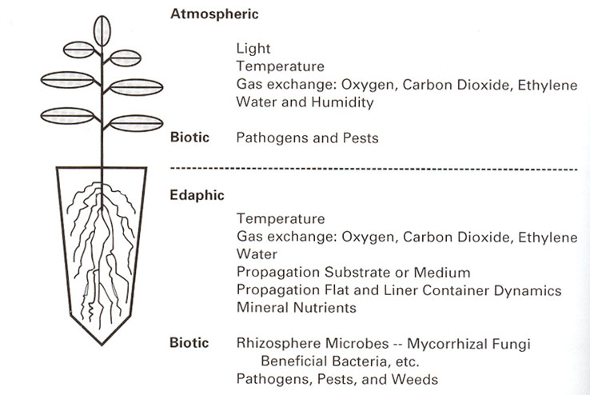
Chap 3. Propagation Environment and Facility
Courtesy: Landis, T.D. (1993)

Slide 2
Environmental Controls
Light
Temperature
Growing Media
Plant Nutrition
Humidity
6. Carbon Dioxide

Slide 3
1. Environmental factors
  Light
        Electromagnetic spectrum
        Solar radiation vs. artificial lights
    Quality
    - what wave length the light belongs to
    - perceived by the human eye as color.
      red light and far-red light
      effects plant height and development
    Quantity
      - intensity or brightness of light
    - radiometric and photometric measurements
    influence on photosynthesis
        c. Duration
        - influenced by longitude and season
        - photoperiods: long-day, short-day, day-neutral

Slide 4
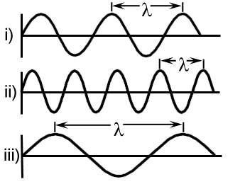
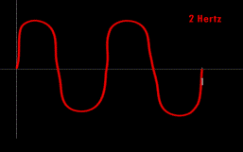
Light Quality
What does it mean?
What spectrum of light does it involve? (Red, blue, green, orange, or infrared lights, etc.)
2. Measurements
a. Wave lengths: distance from peak to peak
or valley to valley in units of nm or µm
µm = 10⁻³ mm
nm = 10⁻⁶ mm
Å = 10⁻³ nm
b. Wave number: number of waves per cm of light (number/cm)
c. Frequency: number of cycles per second (cycles/sec, cps)
Hertz (Hz) = 1 cycle/sec
Mega Hz = 1 million Hz

Slide 5
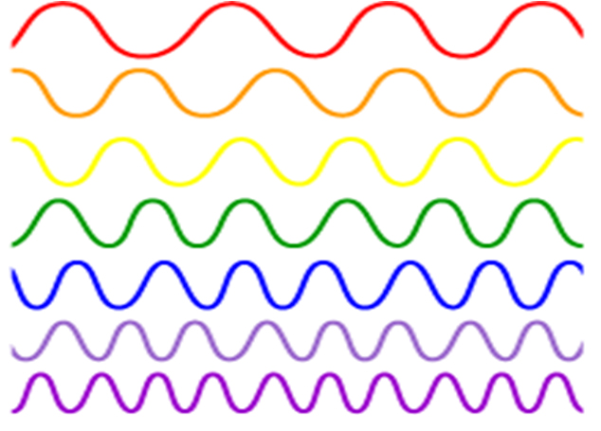
Composition of Visible Light
Red
Orange
Yellow
Green
Blue
Indigo
Violet
Source: NASA

Slide 6
Light Intensity
1. What does it mean?
How much irradiated on the surface (Quantity)
2. Radiometric measurements
a. Light intensity measured in terms of power of radiation on a unit surface area
Power = energy/unit time
Intensity = power/unit area, energy/unit area per unit time
b. Measurement units: Joules cm⁻² sec⁻¹, watts cm⁻², BTU ft⁻² hr⁻¹, kcal cm⁻² hr⁻¹
c. The shorter the wave length, the more the energy available.
3. Photometric measurements
a. Light intensity expressed in terms of illuminance or how bright the light is (visible radiation only)
b. Measurement units: Foot candles, lumens, lux, µmol m⁻² sec⁻¹
c. Relationships: 1 lux = 1 lumen m⁻²
1 foot candle = 10.76 lux
4. Factors affecting light intensity
a. Moisture in the air: No. of clear days in January: 70-80% in AZ, 30-40% in NY
b. Topography: Higher the altitude, brighter the light
c. Pollutants in the air: PAN, SO₂, NOx, etc.

Slide 7
Duration of Light
1. What does it mean?
How long the light was on
2. Factors that affect light duration
a. Time of the year (seasonal variation)
b. Latitudes (both northern and southern hemisphere) Fargo: 56.5 N
3. Photoperiod responses
a. Long day plants (short night plants)
Requires days longer than 16 hours to bloom
Aster, petunia, potato
b. Short day plants (long night plants)
Requires days shorter than 13 hours to bloom
Chrysanthemum, poinsettia, kalanchoe
c. Mechanism of responses
Phytochrome system
P₆₆₀ – red light absorbing form
P₇₃₀ – far-red light absorbing form

Slide 8
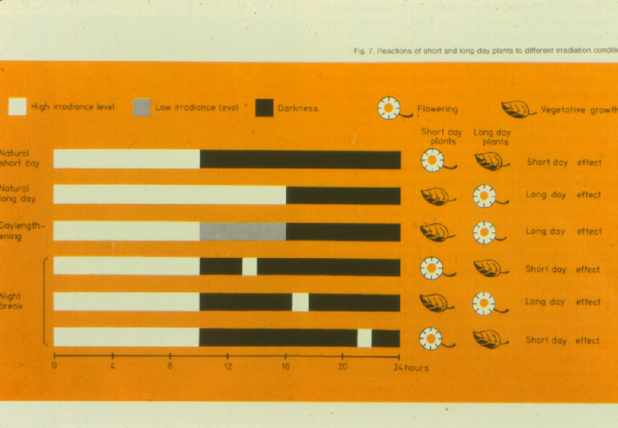
Influence of Photoperiod on Flowering

Slide 9
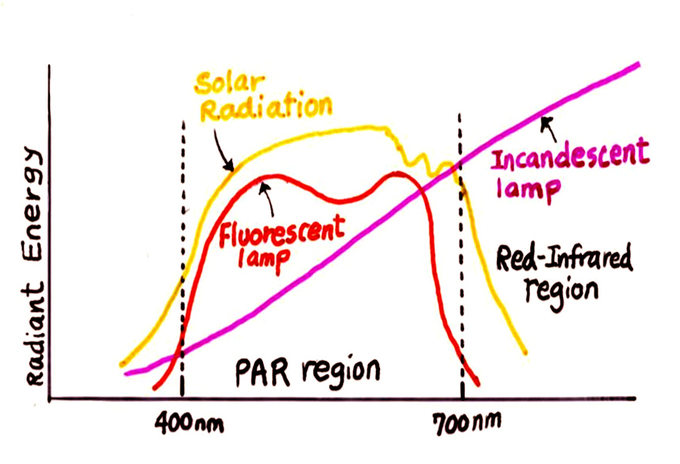
Spectral Distribution of Various Lamps

Slide 10
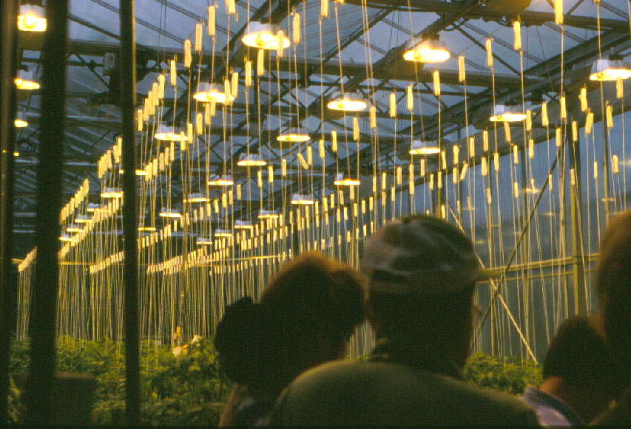
Lighting for Photosynthesis

Slide 11
1. Environmental factors (continued)
  B. Temperature
    Optimum temperature
    - For most plants: 70 ºF day and 60 ºF night
    Importance – some examples
    - Cold-moist stratification breaks dormancy of some seeds
      - Warm temperature of soil medium improves germination and rooting
      - Heat applied to graft union to speed callusing and tissue joining
      - Bottom heat on propagation bench stimulates rooting, more cost-effective than heating whole greenhouse.

Slide 12
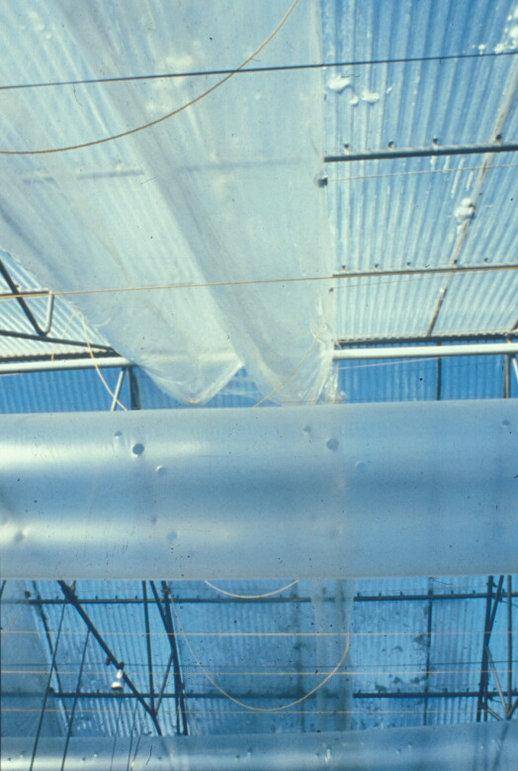
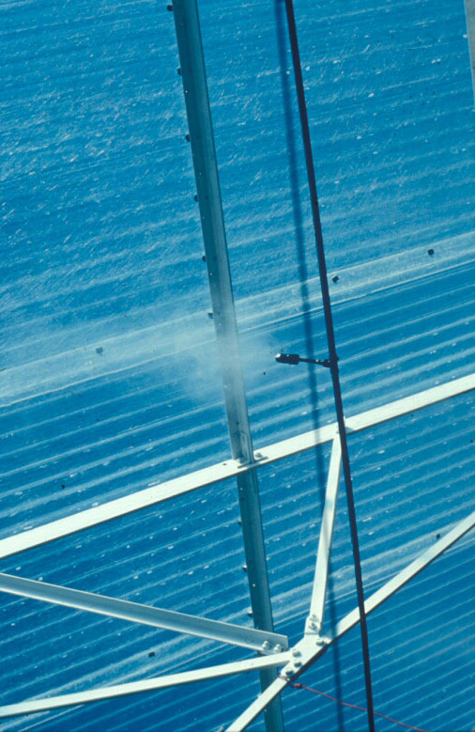

Slide 13
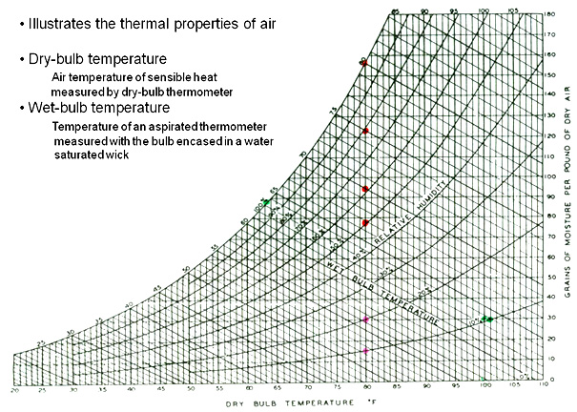
Use of psychrometric chart in greenhouse cooling

Slide 14
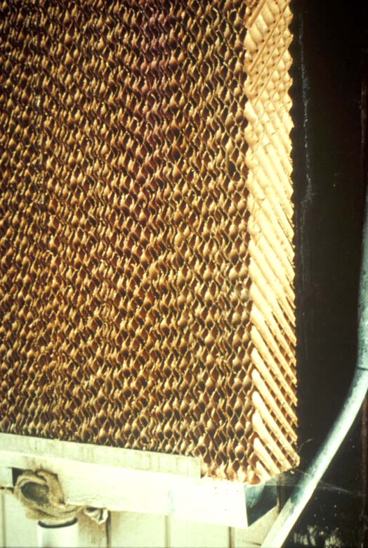
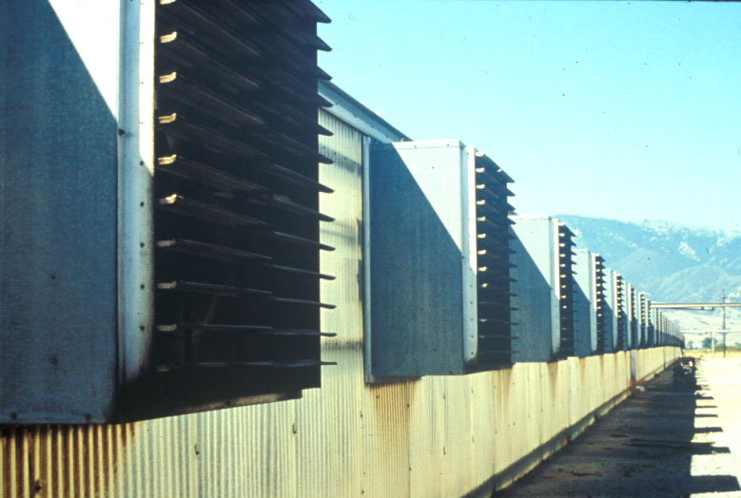
Pad and Fan Evaporative Cooling System

Slide 15
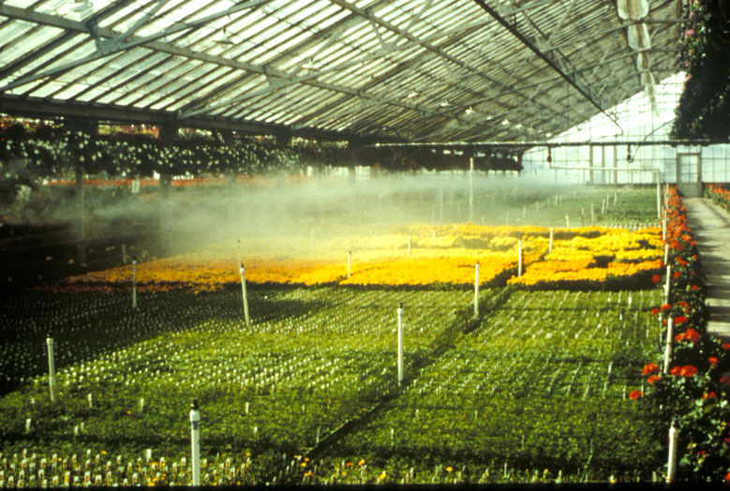
High pressure fogging system

Slide 16
Growing Media
Ideal Composition
Solid 50%
45% mineral
5% organic matter
Water 25%
Air 25%

Slide 17
Soil Amendments
  Sand: low water-holding, low CEC, heavy, size varies
  used as inert medium
  Vermiculite: expanded mica mineral
  high water-holding, good CEC, high buffering
  Perlite: heated, popped volcanic rock (inert)
  very light, no CEC, no buffering or nutrient holding
  Calcined Clay: baked montmorlillonite clay, aggregate particles
  heavy, durable, high CEC
  Pumice: Crushed volcanic rock (inert)
  low water-holding, low CEC
  Peat: about 75% decomposed sphagnum peatmoss
  high water-holding, high CEC, low pH

Slide 18
Using Soil in Growing Media
  Heavy Texture Soil
  Use: 1 part clay loam
  2 parts organic matter
  2 parts coarse aggregate (amendments)
  b. Medium Texture Soil
  Use: 1 part silty loam
  1 part organic matter
  1 part coarse aggregate (amendments)
  c. Light Texture Soil
  Use: 1 part sandy loam
  1 part organic matter

Slide 19
Adjustment of Soil pH
To raise soil pH
  Ground limestone (CaCO₃)
  Dolomitic lime (mixture of CaCO₃ + MgCO₃)
  Gypsum (CaSO₄)
To lower soil pH
  Sulfur powder (S)
  Aluminum sulfate [Al₂(SO₄)₃]
  Iron Sulfate (FeSO₄)
  For solution, use:
    Sulfuric Acid (H₂SO₄ ------------► 2H⁺ + SO₄⁻²)
    Phosphoric Acid (H₃PO₄ ------------► 3H⁺ + PO₄⁻³)
    Nitric Acid (HNO₃ ------------► H⁺ + NO₃⁻)

Slide 20
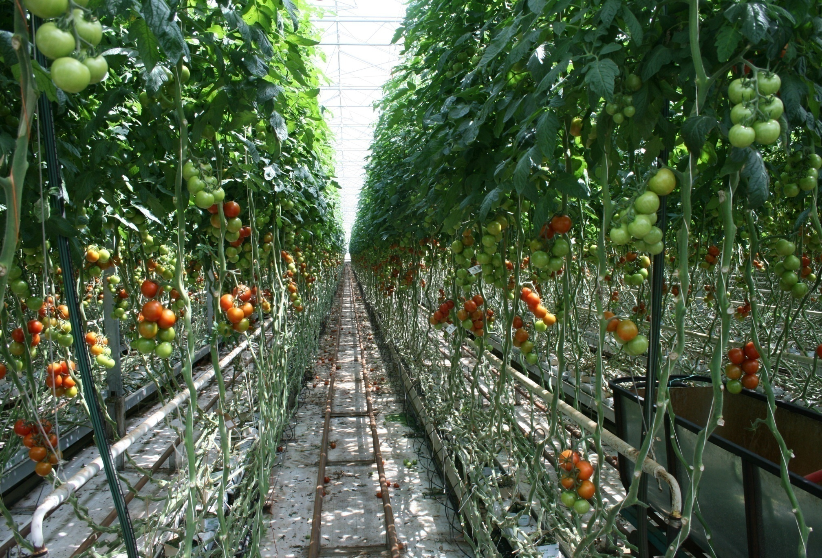
Rockwool used as growing media for tomato production

Slide 21
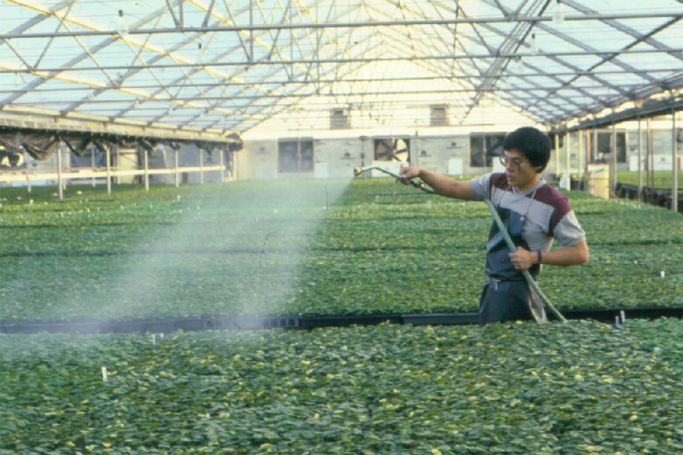
Fertilizer Application

Slide 22
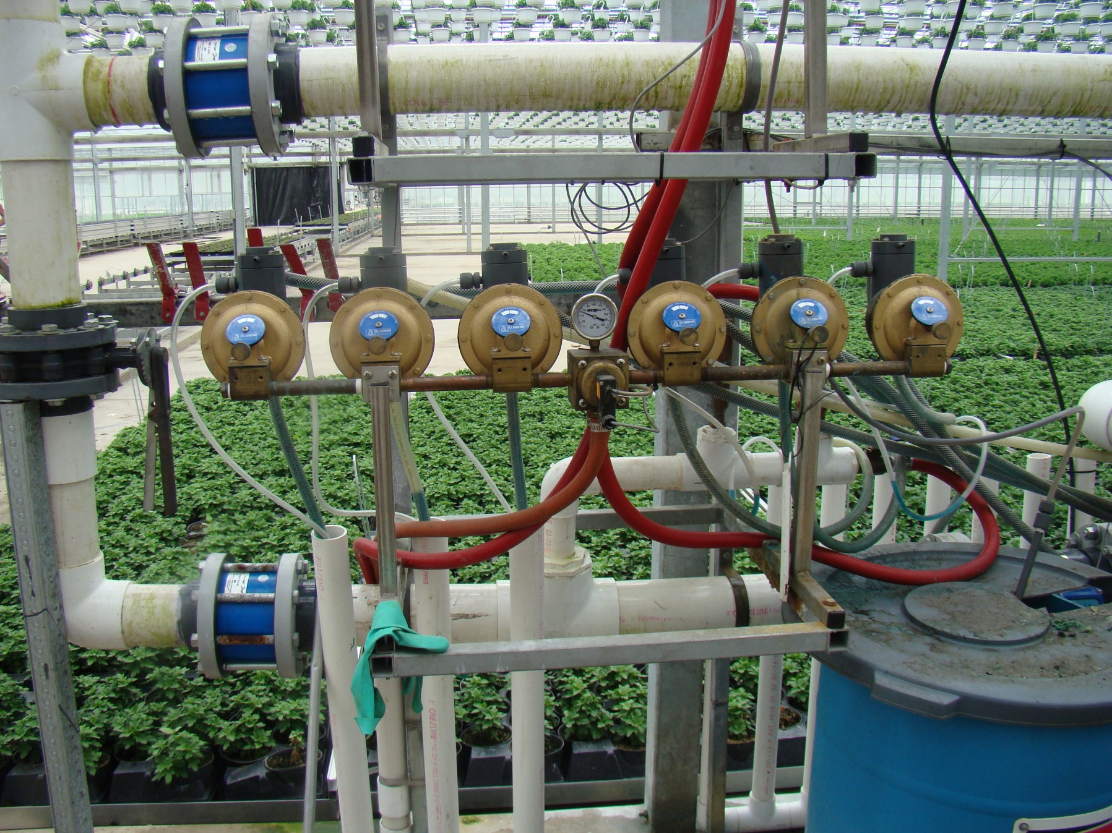
Fertilizer Injection

Slide 23
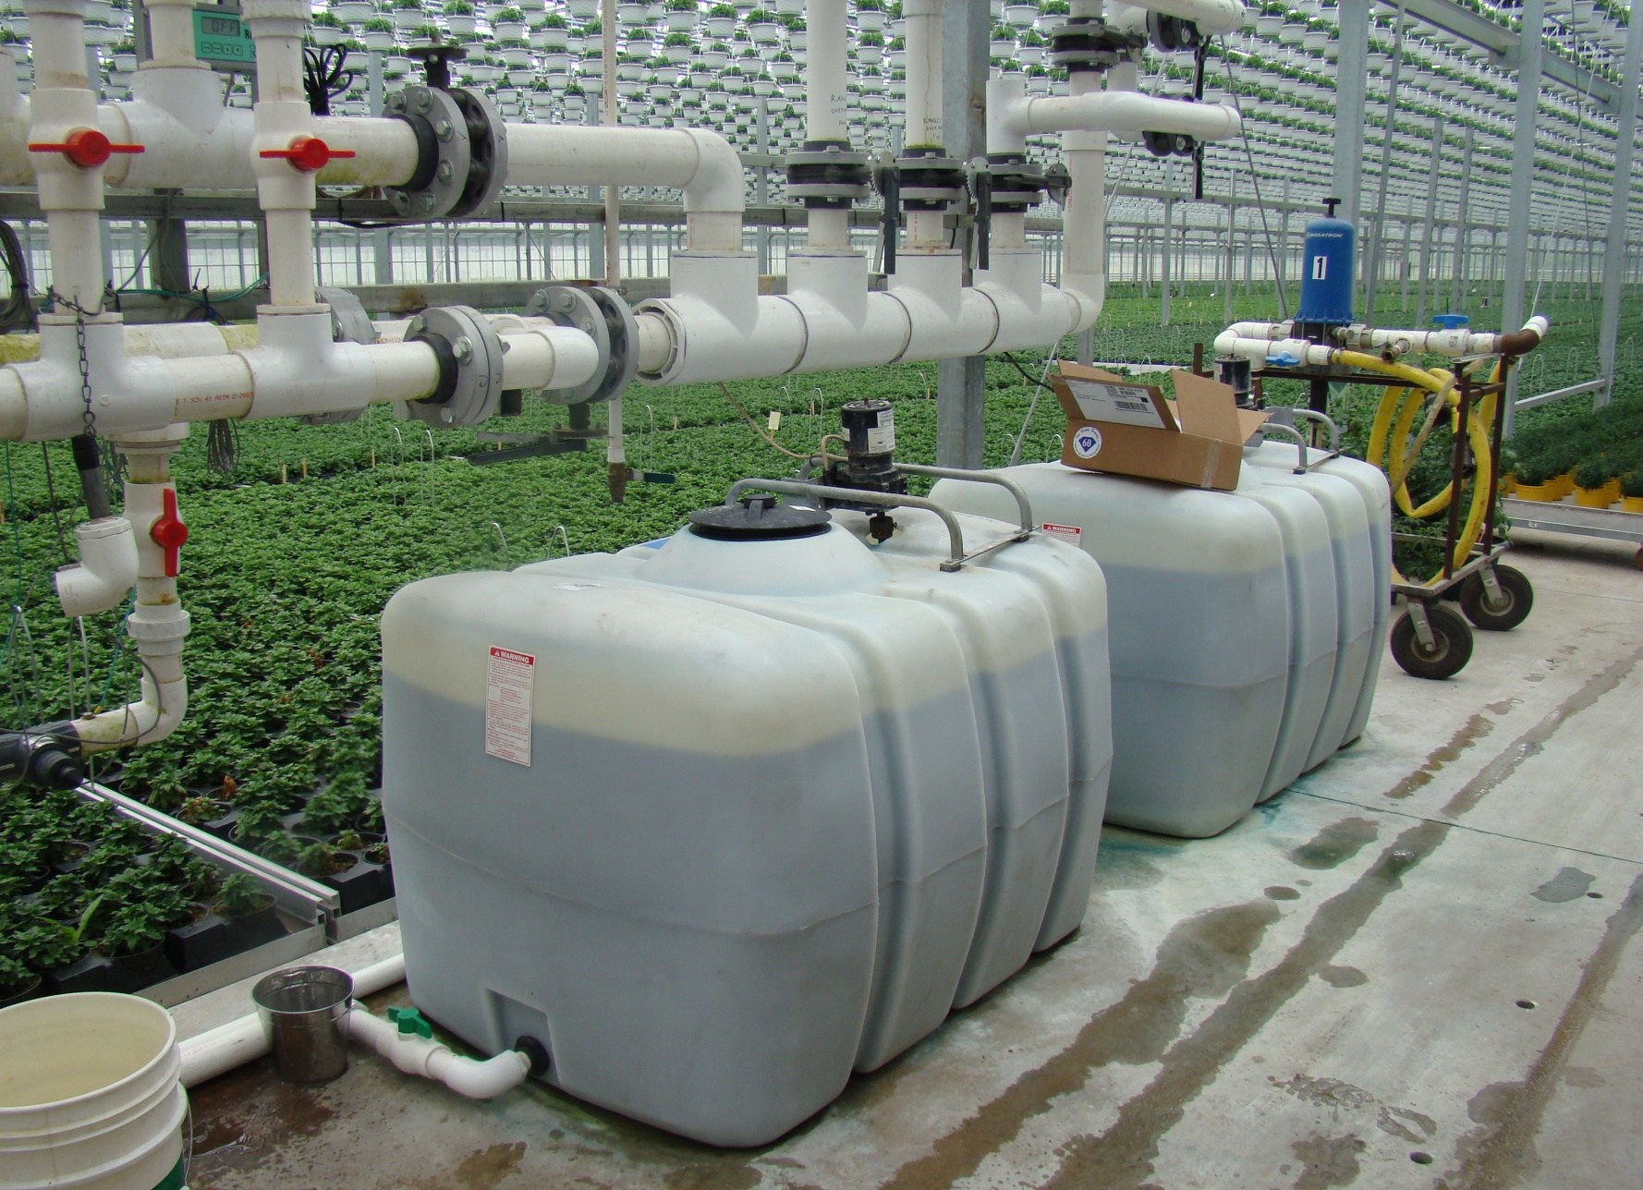
Fertilizer Stock Tanks

Slide 24
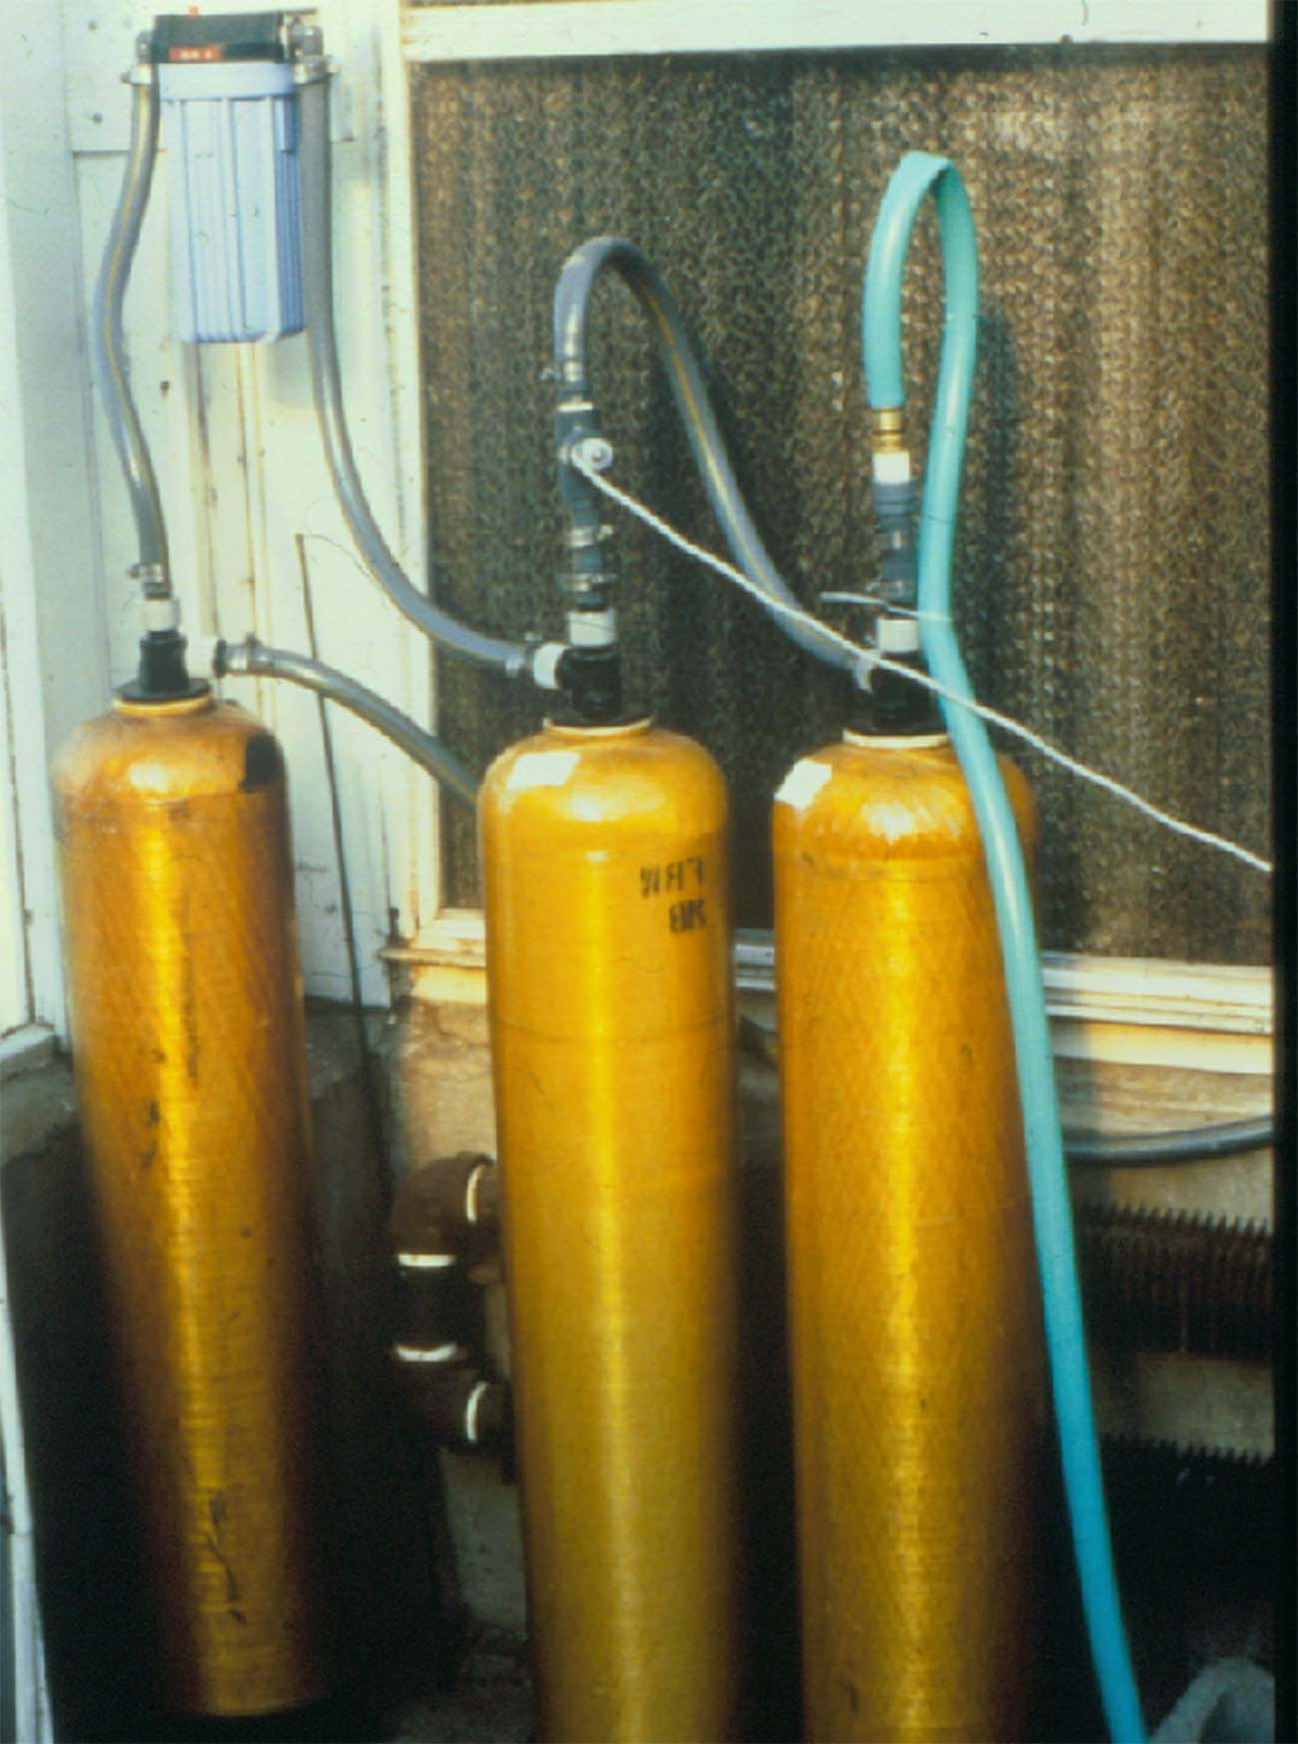
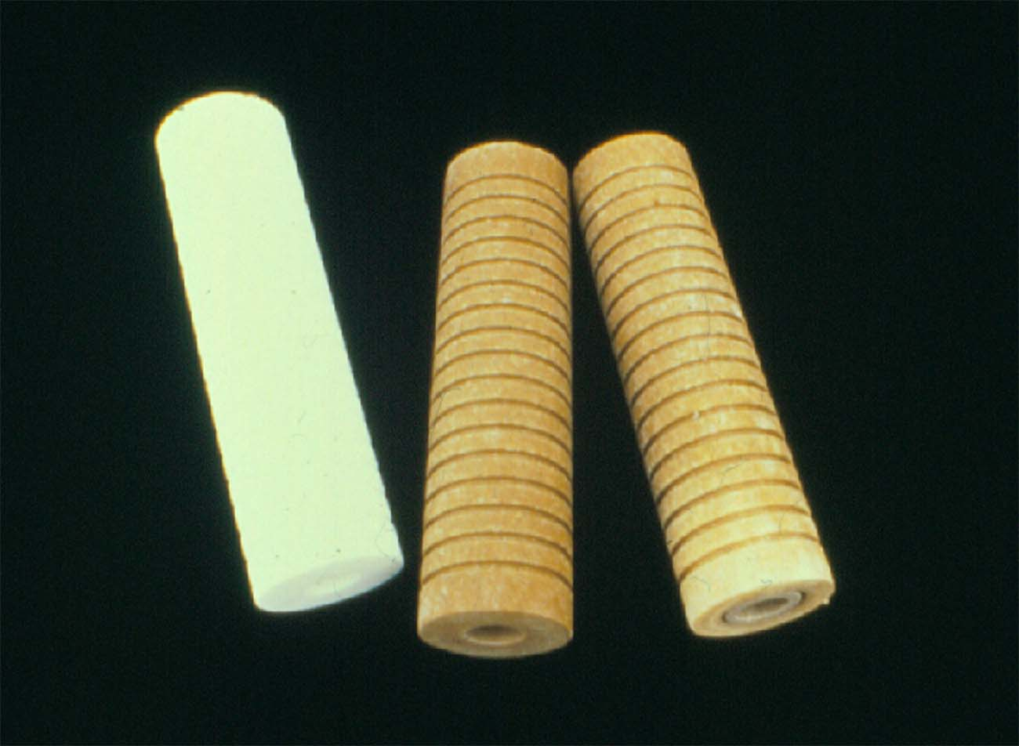
Purification of Water
Filtration
Reverse Osmosis (RO water)
Distillation (DI water)

Slide 25
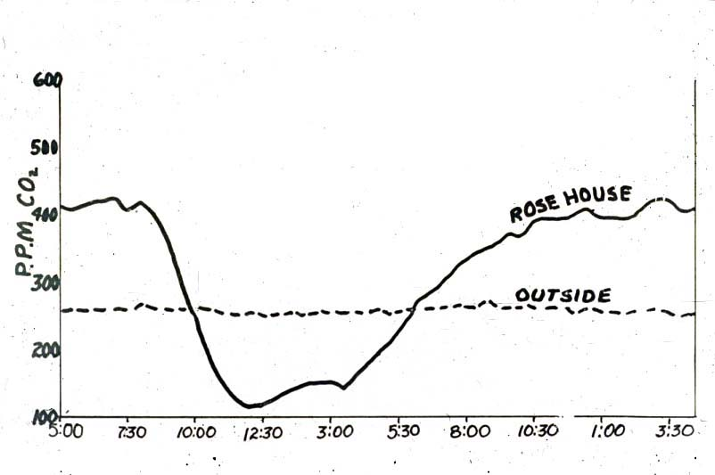
Fluctuation of CO₂ Concentration
Inside a Greenhouse in One Day

Slide 26
2. Environmental Control Facility
Cold frames
Hotbeds
Greenhouses
Shade houses
Other structures

Slide 27
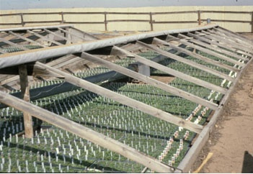
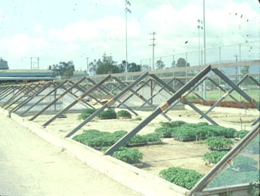
Cold Frames
Semi-controlled environment
Used for hardening seedlings and rooted cuttings
Can also be used for vernalizing herbaceous perennials

Slide 28
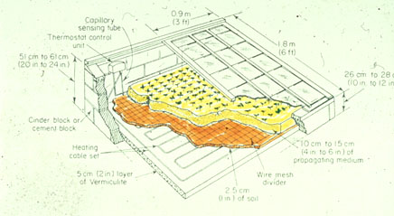
Hotbeds
Small, low structures for minimum environmental control
Some bottom-heated
- Use of electrical cables, hot water, stream
- Heat from organic waste (manure, straw) was used earlier days
Possible problems
  Seedling damping-off (Pythium, Rhizoctonia)
  Complete control of temperature difficult

Slide 29
Structural Designs of Greenhouse
1. Lean-to Greenhouses
2. Single Span Greenhouses
- Even-span greenhouses
- Uneven-span greenhouses
- Arch or curvilinear greenhouses
3. Ridge-and-Furrow Greenhouses
- Gutter connected multi-span greenhouses

Slide 30
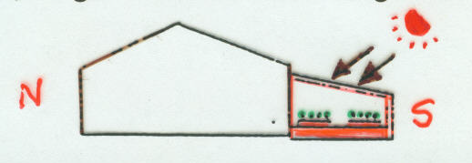
1. Lean-to Greenhouses
Build against a side of an existing building
Advantages: Less heating costs
Easy access to harvesting crops
Disadvantages: Humid air into the house
Chemical spray health hazard (use biological control)

Slide 31
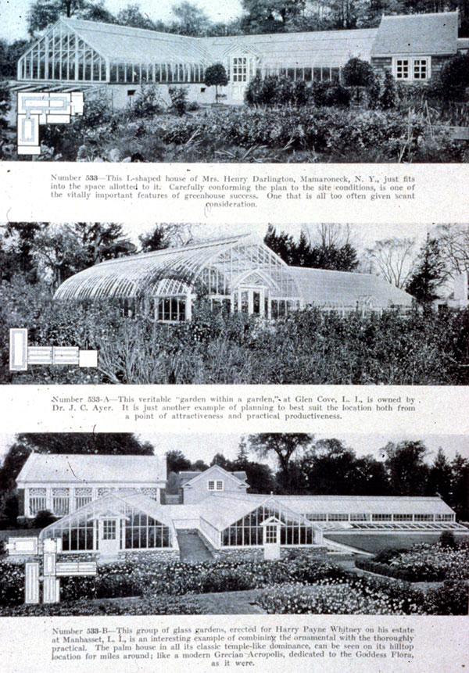
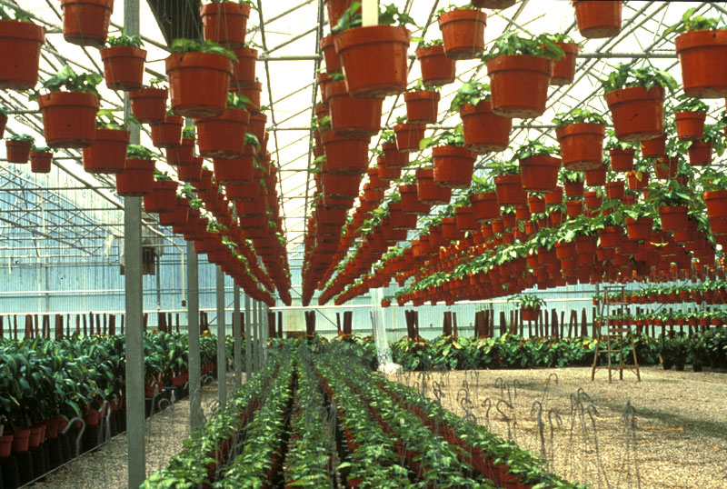
Earlier Greenhouses
Modern Greenhouses

Slide 32
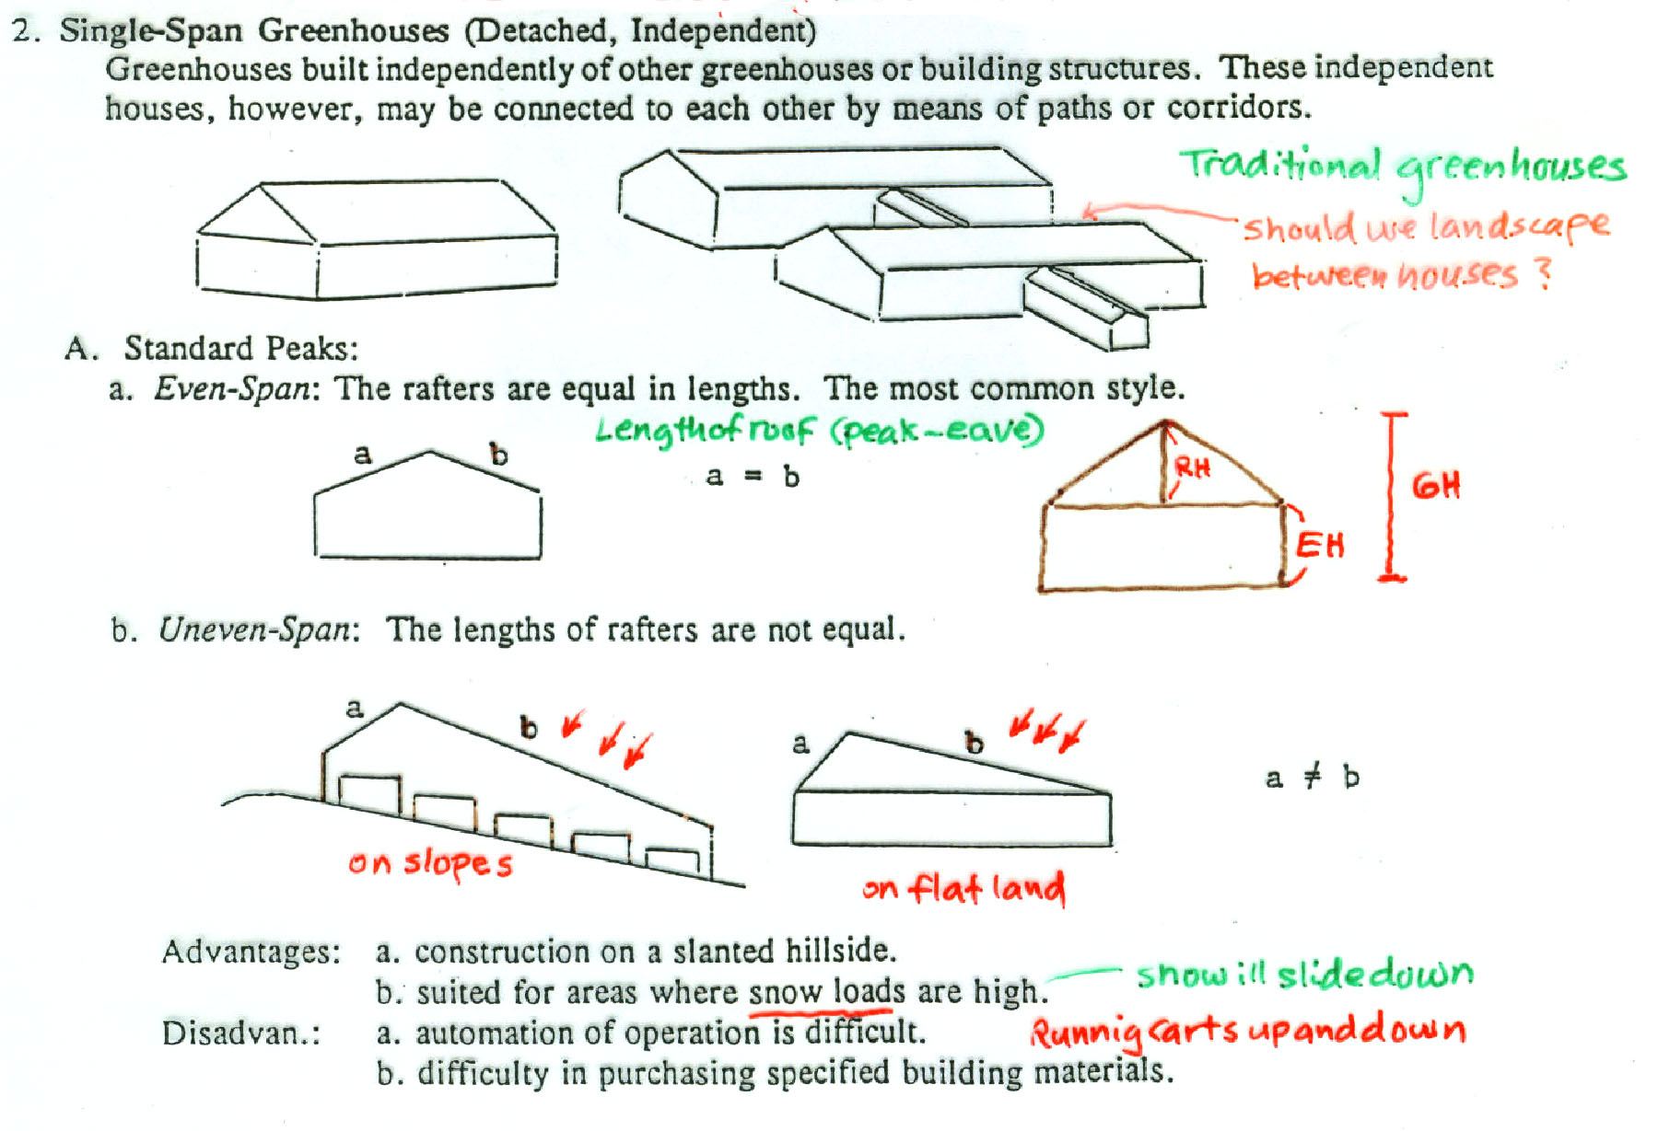
2. Single-Span Greenhouses

Slide 33
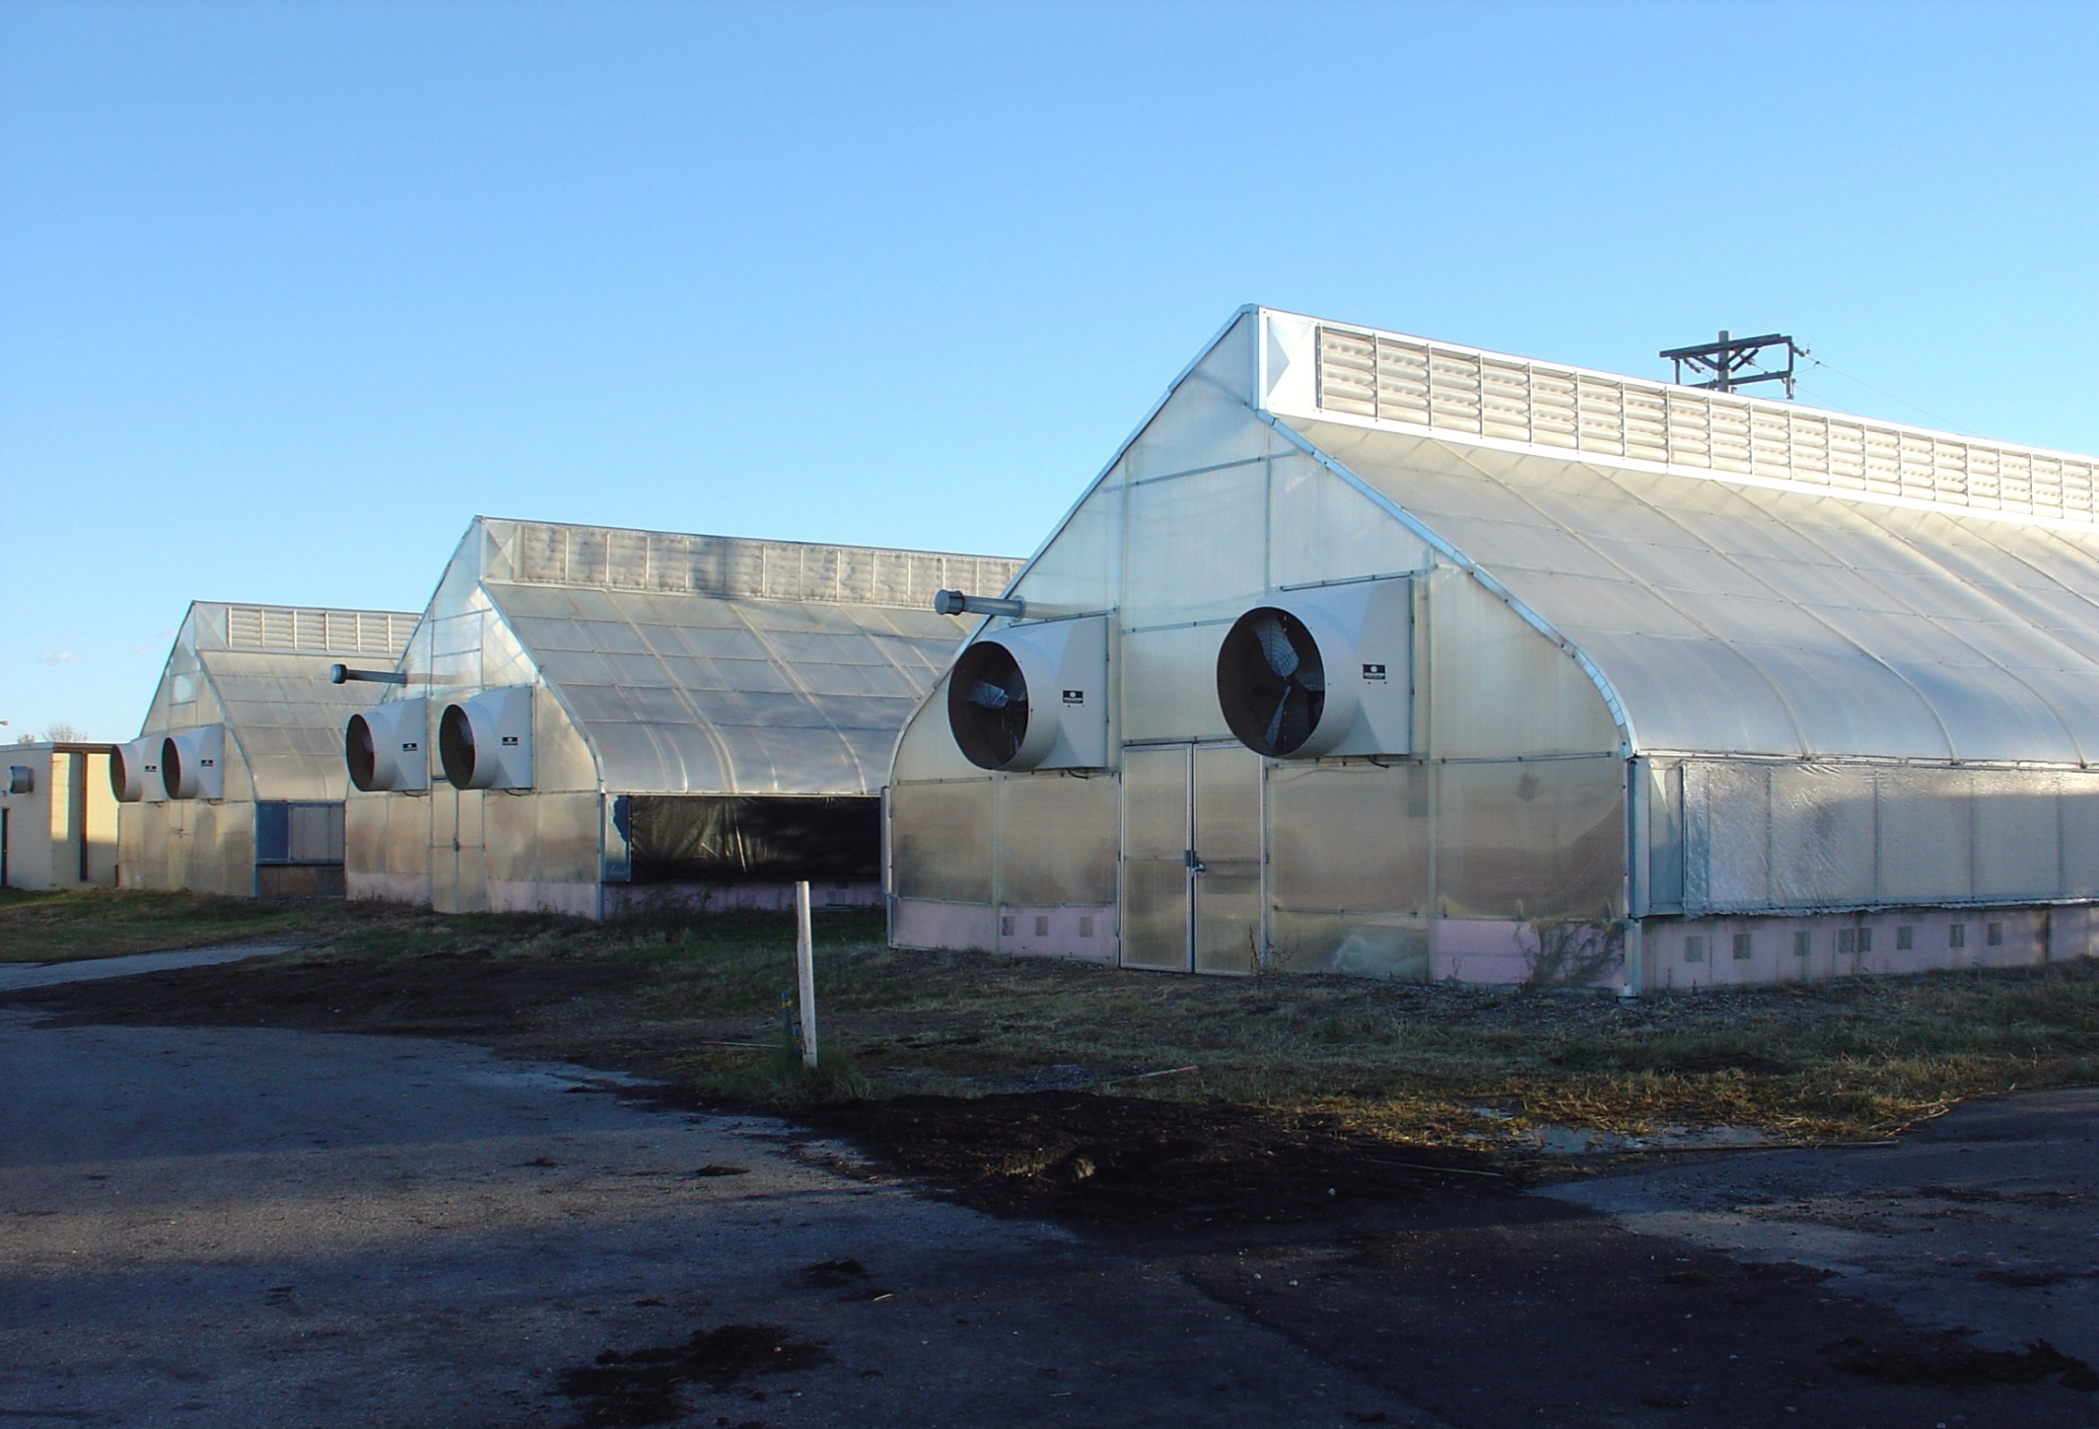
Modified temporary Quonset greenhouses, NDSU campus

Slide 34
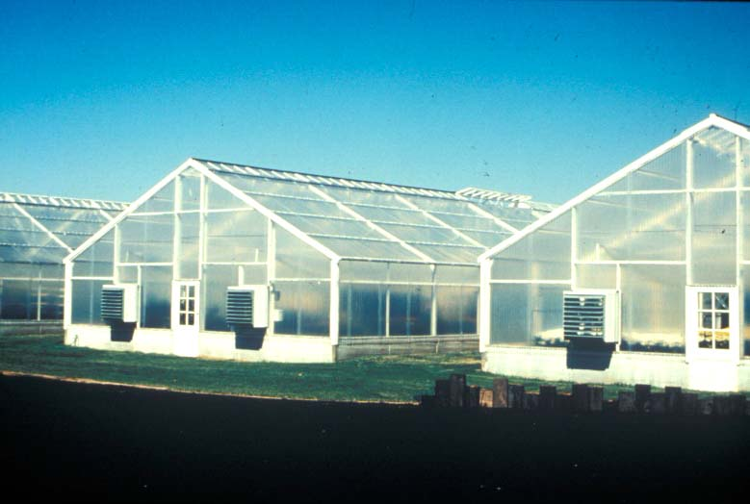
Standard Single-Span Greenhouses

Slide 35
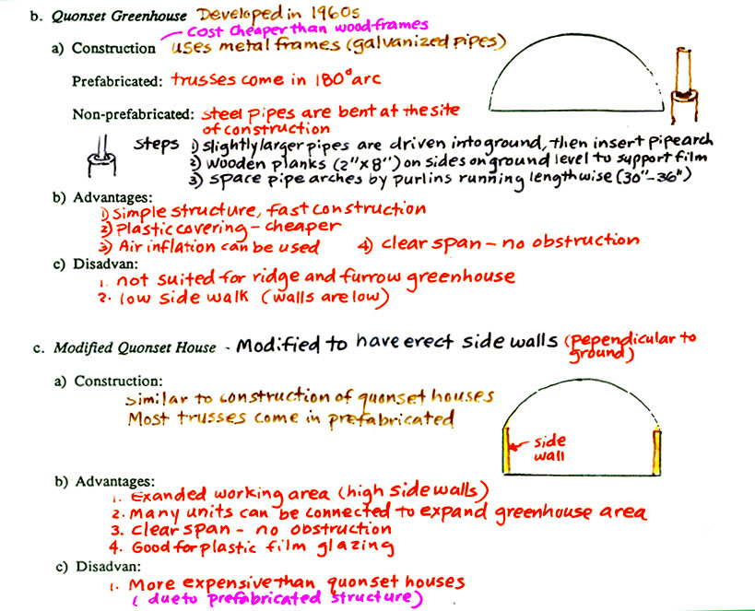

Slide 36
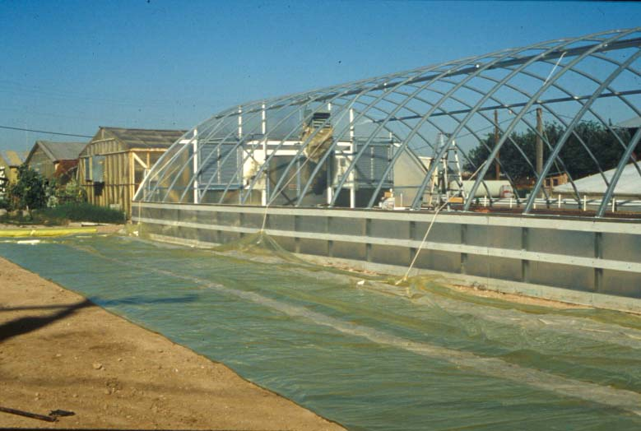
Construction of a Quonset Greenhouse

Slide 37
